Slide 1
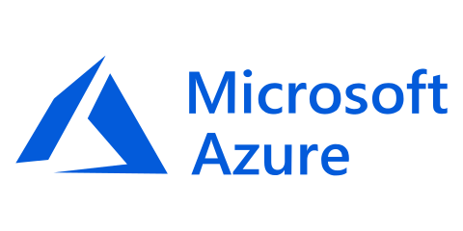
Provision, secure, connect, and run any infrastructure for any application
WiFi:
MSFTGUEST
Access Code:
msevent0000
bit.do/terraformworkshop
Notes:
Hi, my name is ________. I am the __________ for HashiCorp and here to talk about Terraform, one of the product in the HashiCorp Suite.
The mission of the HashiCorp suite is to provide products singularly focused on a goal: a product to provision, one to secure, one to run, and one to connect any infrastructure for any application.
Today we will talk about the provisioning piece with Terraform.

Slide 2




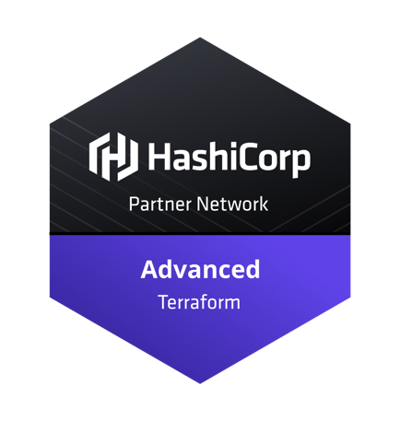
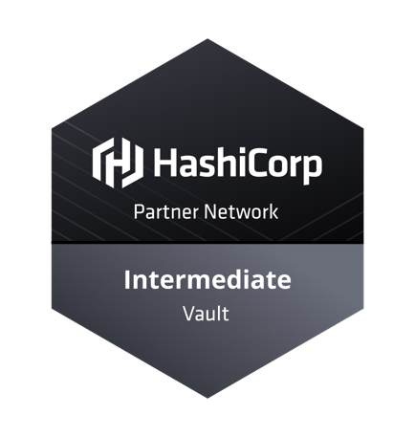
Tom Straub
I
Code

Slide 3



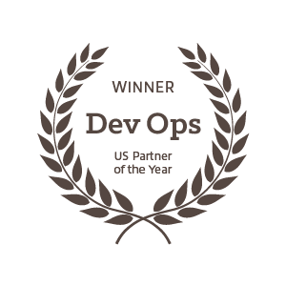
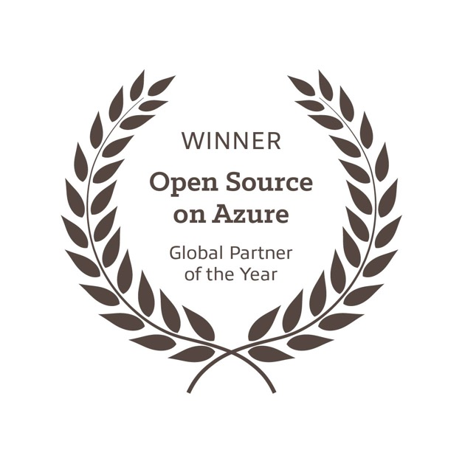
Partners
https://www.insight.com/digital-innovation
Notes:
to provide better technology solutions that advance your business.
Who is Cardinal?
Cardinal Solutions is a national solution provider. We lead with our experience and expertise in digital solutions across cloud, data and analytics, mobile, and web, while collaborating with clients through an agile process that allows organizations to be more creative and flexible in responding to user and stakeholder feedback. Established over 20 years ago, we continually evolve our solution offerings to adapt to the changes in technology and the needs of our customers. With 500 employees in seven locations in the Midwest and Southeast, we connect with clients across the country to help advance their business, while also providing strategic guidance, training, and mentoring.
Cardinal has a rich history of digital transformation with Azure. Our expertise in native cloud applications, mobile/digital, internet of things, analytics, and modern data center (including open source solutions) enables us to develop complex software solutions in the cloud. Our approach is to educate the customer on the possible, via real-life case studies, with the focus on innovation. Our portfolio includes over 50 successful deployments that range across a variety of industries and workloads. We help you craft a strategy that gets you started on the path to innovation in the cloud.

Slide 4
What’s in a Workshop
Slides -> Challenges -> Slides -> Challenges
Workshop Repository-> bit.do/terraformworkshop
Import links are at the bottom of the slides
https://github.com/CardinalNow/TerraformWorkshop
Notes:
Recipe for success
This presentation is in the /docs folder
Mix of presentation and hands on labs
Links for more information

Slide 5
Agenda
Hashicorp Overview
Terraform Workflow
Challenge: Connecting to Azure
State, Variables, & Outputs
Challenge: ACI
Interpolations & Modules
Challenge: Azure VM
Backend & Internals
Challenge: Public Registry
Terraform Enterprise
Collaboration & Private Registry
Governance
Demo: Terraform Enterprise
Closeout & Questions
Lunch
Notes:
Intro and Overview of IaC, Terraform, and Azure – give us a solid base to start discussing higher level topics
Lunch – Solution Discussion, Free form, whiteboard

Slide 6

Cloud Infrastructure Automation

Slide 7
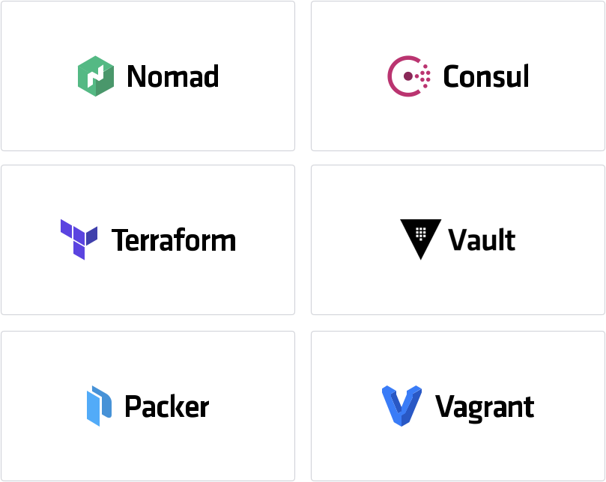
Company Overview
Founded in 2012 by Mitchell Hashimoto and Armon Dadgar
Enabling the Cloud Operating Model Provision, Secure, Connect, and Run any infrastructure for any application

Slide 8
The Transition to Multi-Cloud
Notes:
<note to presenter> frame the discussion to indicate that there are really three pictures that matter
#1 is the transition in infrastructure
#2 is how we think about them in layers
#3 is what success looks like in terms of core Terraform, Vault and Consul as a shared service

Slide 9
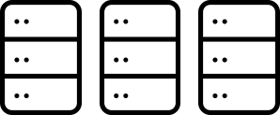
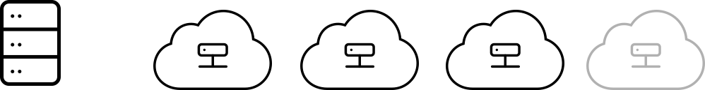

The Transition to Cloud and Multi-Cloud
Traditional Datacenter “Static”
Modern Datacenter “Dynamic”
Dedicated Infrastructure
Private Cloud
AWS
+
Azure
+
GCP
+
...
Notes:
Talk about what’s happening in the world of infrastructure where we are going through a transition that happens in our industry every 20 years: this time from one which is largely dedicated servers in a private datacenter to a pool of compute capacity available on demand. In simple terms, this is a shift from “static” infrastructure to ‘dynamic infrastructure’ which is the reality of cloud.
And while the first cloud provider was AWS, it is clear that it will be a multi-cloud world. Each of these platforms have their own key advantages and so it is inevitable that most G2K organizations will use more than one. This is not about moving applications around (since data gravity is a constraint) but rather creates a need for a common operating model across these distinct platforms that allows different teams to leverage the platform for their choice.

Slide 10
The Transition to Cloud and Multi-Cloud
Traditional Datacenter “Static”
Modern Datacenter “Dynamic”
Dedicated Infrastructure
Private Cloud
AWS
+
Azure
+
GCP
+
...
“Tickets-based”
“Self service”
Notes:
Talk about what’s happening in the world of infrastructure where we are going through a transition that happens in our industry every 20 years: this time from one which is largely dedicated servers in a private datacenter to a pool of compute capacity available on demand. In simple terms, this is a shift from “static” infrastructure to ‘dynamic infrastructure’ which is the reality of cloud.
And while the first cloud provider was AWS, it is clear that it will be a multi-cloud world. Each of these platforms have their own key advantages and so it is inevitable that most G2K organizations will use more than one. This is not about moving applications around (since data gravity is a constraint) but rather creates a need for a common operating model across these distinct platforms that allows different teams to leverage the platform for their choice.

Slide 11
The Transition to Cloud and Multi-Cloud
Traditional Datacenter “Static”
Modern Datacenter “Dynamic”
Dedicated Infrastructure
Private Cloud
AWS
+
Azure
+
GCP
+
...
SYSTEMS OF RECORD
SYSTEMS OF ENGAGEMENT
“Tickets-based”
“Self service”
Notes:
As has been the case in every prior infrastructure transition, the catalyst for this shift is a change in the TYPE of application being built today.
These new ‘systems of engagement’ (credit Geoffrey Moore) — those applications built to engage customers and users — tend to (a) be very “spikey” in their usage characteristics (100K users at noon and 100 users at midnight) and (b) are under enormous pressure to be built quickly. Both of those characteristics make it inevitable that they will be on cloud.
However invariably these new ‘systems of engagement’ must connect to ‘systems of record’ (e.g. the core database, the core mainframe system etc.) on-premises, and so organizations end up in this hybrid world whether they like it or not.
http://wiki.p2pfoundation.net/Systems_of_Engagement

Slide 12
Implications of the Cloud Operating Model
STATIC
DYNAMIC
Dedicated servers
Homogenous
Capacity on-demand
Heterogenous
Provision
Notes:
Let’s decompose the implications of this new model.
At the infrastructure layer, you go from running dedicated servers which are homogenous and limited in scale.
In a dynamic environment , organizations can spin up hundreds and thousands of servers when they need them and destroy them after they are done. Clearly the methodologies and tooling have to evolve significantly here: rather than using vCenter to provision a VM, Ops now has to potentially provision 100K compute nodes at a time.

Slide 13
Implications of the Cloud Operating Model
STATIC
DYNAMIC
High trust
IP-based
Low trust
Identity-based
Secure
Dedicated servers
Homogenous
Capacity on-demand
Heterogenous
Provision
Notes:
At the security layer, we move from a fundamentally high trust world enforced by a strong network perimeter and firewall to one where the default assumption is LOW trust. You no longer have a clear perimeter in cloud, and you also don’t control that network.
As a result the foundational assumption changes: from IP-based (e.g. everything in this IP range can talk to anything else) to IDENTITY as the basis for security. I need to authenticate the IDENTITY of any requestor inside the network before I give them access.
This shift is extremely disruptive to traditional security models.

Slide 14
Implications of the Cloud Operating Model
STATIC
DYNAMIC
Host-based
Static IP
Service-based
Dynamic IP
Connect
High trust
IP-based
Low trust
Identity-based
Secure
Dedicated servers
Homogenous
Capacity on-demand
Heterogenous
Provision
Notes:
Similar things happening at the networking layer.
The shift here is from host based networking. Eg. fax machine which has a physical location and IP address and a Phone that also has an IP address. You can enable the two IP addresses to talk to each other.
In the new world, applications by their nature are dynamic (e.g. 100K containers at noon and 10 containers at midnight). In addition, the public cloud vendors will not have a specific physical location for your applications as they keep moving around based on available space and utilization. Hence you don’t control the network and it becomes very difficult to connect two entities based on their physical location.
As a result the only option is to throw out the concepts of the old and move to the world of service-based connectivity. E.g. database 1 can talk to application 1, irrespective of their location.
This is probably the single most common thing that our customers struggle with in this transition to cloud

Slide 15
Implications of the Cloud Operating Model
STATIC
DYNAMIC
Run
Dedicated Infrastructure
Scheduled across the fleet
Host-based
Static IP
Service-based
Dynamic IP
Connect
High trust
IP-based
Low trust
Identity-based
Secure
Dedicated servers
Homogenous
Capacity on-demand
Heterogenous
Provision
Notes:
At the runtime layer, rather than deploying an application artifact to a specific server, in the dynamic world we deploy the artifact to a pool (e.g. k8s).

Slide 16
The Cloud Landscape
STATIC
DYNAMIC
Dedicated
Private Cloud
AWS
Azure
GCP
Run
Development
vSphere
vSphere
EKS/ECS Lambda
AKS/ACS Azure Functions
GKE Cloud Functions
Connect
Networking
Hardware
Various Hardware
CloudMap
AppMesh
Proprietary
Proprietary
Istio
Secure
Security
IP: Hardware
Identity: AD/LDAP
Identity: AWS IAM
Identity: Azure AD
Identity: GCP IAM
Provision
Operations
vCenter
Terraform
CloudFormation
Resource Manager
Cloud Deployment Manager
Notes:
A quick glance at the cloud landscape highlights how different this model is.
Provision: each has a unique tool to provision fleets of any size on-demand
Secure: each has a distinct IDENTITY model
Connect: each has a proprietary networking model which has given rise to the need for Service-based overlay models
Run: they all have multiple offerings here. Container-based offerings are key, but they also all are investing heavily in emerging concepts such as Serverless / Lambda which represent the logical evolution at that layer.
The challenge then for any enterprise Ops and Security team is: how do i reconcile this reality?

Slide 17
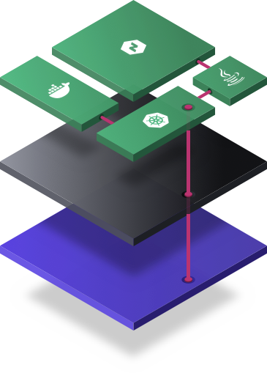

A Common Operating Model with the HashiCorp Suite
Private Cloud
AWS
Azure
GCP
Run
Development
Connect
Networking
Secure
Security
Provision
Operations

Slide 18

Cloud Provisioning with Terraform
A common Cloud Operating Model
Private Cloud
AWS
Azure
GCP
Run
Development
Connect
Networking
Secure
Security
Provision
Operations
Notes:
The way we decompose the problem practically is to say there are four kinds of people in IT (ops, security, networking and developers). And all four of these participants have to figure out how to run infrastructure in this new model. And that's how we think about our product portfolio. So we've taken a very cloud native approach to solving each of those problems independently.
At the infrastructure layer, we have Terraform which is the world's most widely used cloud provisioning product. Terraform is used to provision infrastructure across any application.

Slide 19

Cloud Security with Vault
A common Cloud Operating Model
Private Cloud
AWS
Azure
GCP
Run
Development
Connect
Networking
Secure
Security
Provision
Operations
Notes:
At the security layer its about using identity as the basis for systems access and our product here is called Vault.
Vault is enormously widely used including at products which includes Stock Exchanges, large financial organizations, hotel chains and everything in-between.

Slide 20

Cloud Networking with Consul
A common Cloud Operating Model
Private Cloud
AWS
Azure
GCP
Run
Development
Connect
Networking
Secure
Security
Provision
Operations
Notes:
Similar to how Vault has introduced a totally different way of thinking about security, Consul does the same for networking. Consul is one of our most widely deployed products. We have customers running well north of 100K consul nodes in their environments today.

Slide 21
Cloud Scheduling with Nomad
A common Cloud Operating Model
Private Cloud
AWS
Azure
GCP
Run
Development
Connect
Networking
Secure
Security
Provision
Operations

Slide 22




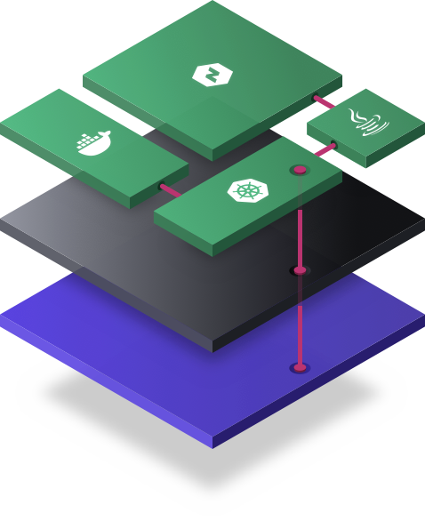
A Common Cloud Operating Model to Accelerate Application Delivery
App
Development
App
Networking
Security
Operations
Notes:
At the application tier is the recognition of heterogeneity of app type. Some will be Containers running on k8s, some will be java apps, some will be VMs and some will be Nomad.
By providing this common cloud foundation, the ops, security and networking teams can be confident their requirements are met for any new application without constraining the deployment process. This is the essence of DevOps.

Slide 23
A Common Cloud Operating Model to Accelerate Application Delivery
App
Development
App
Networking
POLICY
Security
GOVERNANCE
Operations
Notes:
At the application tier is the recognition of heterogeneity of app type. Some will be Containers running on k8s, some will be java apps, some will be VMs and some will be Nomad.
By providing this common cloud foundation, the ops, security and networking teams can be confident their requirements are met for any new application without constraining the deployment process. This is the essence of DevOps.

Slide 24
Open Source vs. Enterprise
GOVERNANCE
ORGANIZATIONAL COMPLEXITY
POLICY
COLLABORATION
COLLABORATION
OPEN SOURCE
OPEN SOURCE
OPEN SOURCE
Individuals
Teams
Pro
Organizations
Premium
Notes:
We differentiate our commercial products based on organizational complexity. Our open source products are all about meeting the needs of the individual, our commercial products add collaboration and the premium version they add elements of policy and governance. Our packaging structures we have a pro version and a premium version.

Slide 25
Terraform Overview

Slide 26
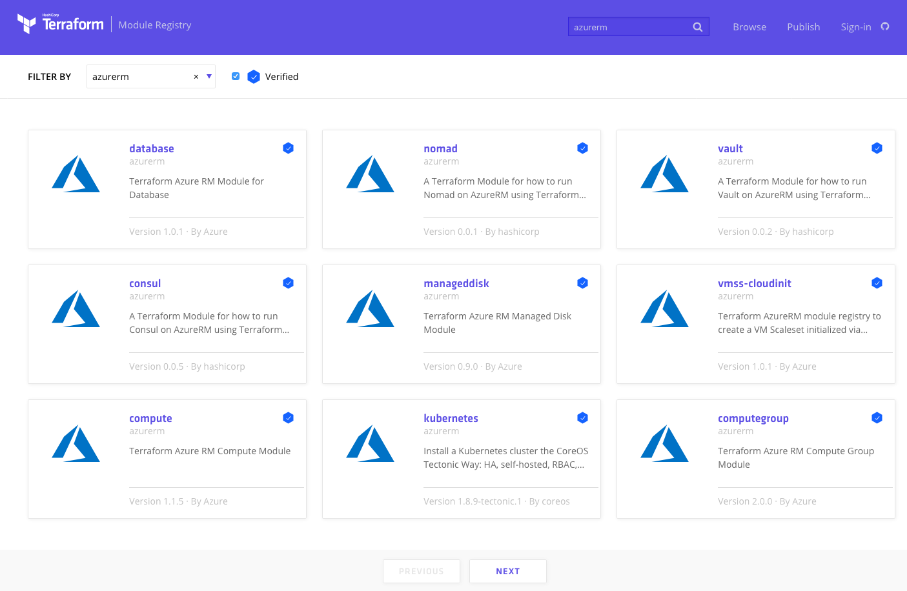
Public Module Registry
https://registry.terraform.io
Notes:
Publish modules
Reusable blocks of code
Terraform Enterprise – offers Private Module Registry

Slide 27
Terraform provisioning workflow
PROVISIONing WORKFLOW
Plan
Core
Provider
Apply
Notes:
Safely Manage Infrastructure
Core and Provider(s) (extensible)
Plan – verification phase
Differences
Dependencies
Apply – execution phase
Makes changes
One workflow, two steps, any infrastructure.

Slide 28

Terraform provisioning workflow
INFRASTRUCTURE AS CODE
PROVISIONing WORKFLOW
Module
Registry
DEVELOPER
Plan
OPERATOR
Provider
VCS
Core
Apply
Notes:
Input - Terraform Configuration
Holistic config or module (reuse)
Public module registry, free to use/submit

Slide 29
Provision any infrastructure for any application
Extensible provider model
AWS
GCP
Core
Azure
Alibaba
API Integration
Notes:
Extensible Providers
Over 90

Slide 30

Provision any infrastructure for any application
Extensible provider model
AWS
GCP
OPERATIONS
Core
Azure
Provision infrastructure
Alibaba
API Integration
Notes:
Cloud providers: AWS, Azure, GCP, Alibaba, Oracle, IBM, and more

Slide 31
Provision any infrastructure for any application
Extensible provider model
Fastly
GitHub
…
Kubernetes
Heroku
…
DNSimple
Akamai
…
Datadog
F5
…
AWS
GCP
OPERATIONS
Core
Azure
Provision infrastructure
Alibaba
API Integration
Notes:
Other ISVs providers: DNSimple, Datadog, Consul, GitHub, Fastly, and more

Slide 32
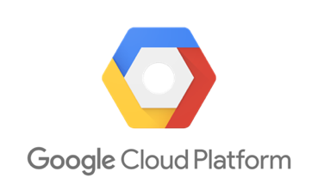



Terraform Ecosystem
Partnerships with 45+ technology providers, community support for many more
Version-control Systems
Infrastructure providers
Core
Provider
List of all 90+ providers www.terraform.io/docs/providers/
Notes:
Partnerships
VCS support

Slide 33
Provision any infrastructure for any application
Infrastructure as Code
OPERATOR
Core
Azure
Terraform Configuration
Notes:
Today we will look at Azure

Slide 34
Provision any infrastructure for any application
OPERATOR
Core
Azure
Kubernetes
Datadog
Notes:
- Consistent workflow for every provider
- Codify resource in a Terraform configuration
- Producer & consumer model
Operators produce infrastructure configurations
Developers consume infrastructure configurations

Slide 35
Provision any infrastructure for any application
Infrastructure as Code
DEVELOPERS
OPERATOR
Core
Azure
Kubernetes
Terraform Configuration
Datadog
Notes:
- Consistent workflow for every provider
- Codify resource in a Terraform configuration
- Producer & consumer model
Operators produce infrastructure configurations
Developers consume infrastructure configurations

Slide 36
Azure Resource Manager

Slide 37
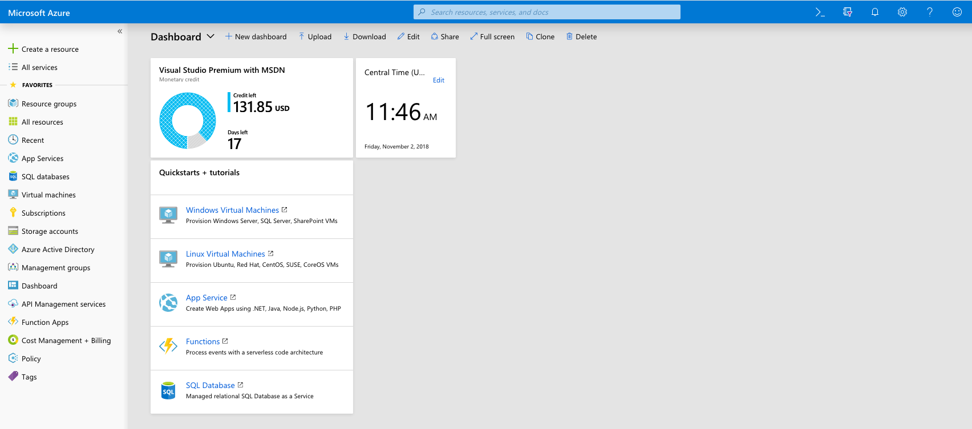
Azure Portal
https://portal.azure.com
https://portal.azure.com
Notes:
We will be using this throughout the day

Slide 38
High Level View
Notes:
Every Tenant can have multiple subscriptions (but a sub can only be in a single tenant)
Each Subscription can have multiple resource groups (but a RG can only be in a single sub)
Each resource can have multiple resources (but a resource can only be in a single RG)
Mention Location/Regions

Slide 39
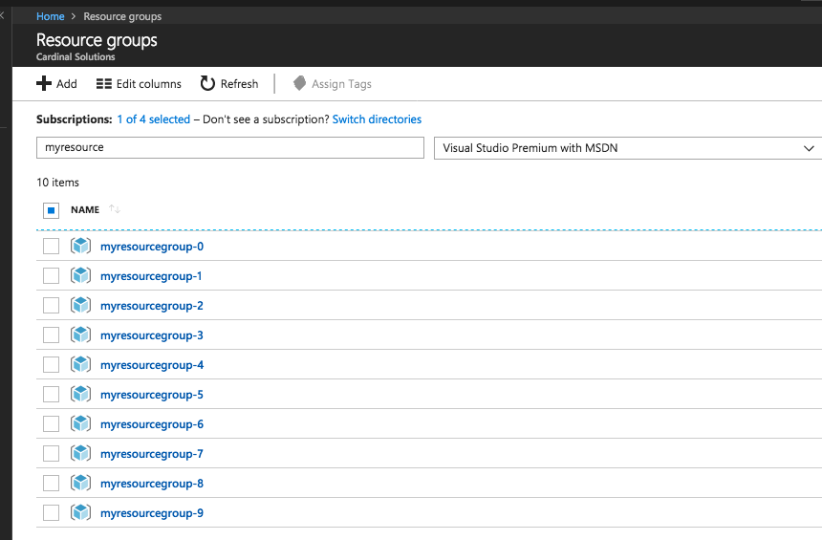
Azure Resource Manager
Resource Group
A container that holds
related resources.
https://portal.azure.com
Notes:
resource group
A container that holds related resources for an Azure solution. The resource group can include all the resources for the solution, or only those resources that you want to manage as a group.
You can deploy, update, or delete all the resources for your solution in a single, coordinated operation.
resource provider
A service that supplies the resources you can deploy and manage through Resource Manager.
Each resource provider offers operations for working with the resources that are deployed.
Some common resource providers are Microsoft.Compute, which supplies the virtual machine resource, Microsoft.Storage, which supplies the storage account resource, and Microsoft.Web, which supplies resources related to web apps. See Resource providers.

Slide 40
Azure Resource Manager
Resource
A manageable item that is available through Azure.
Some common resources are a virtual machine, storage account, web app, database, and virtual network, but there are many more!
Notes:
resource group
A container that holds related resources for an Azure solution. The resource group can include all the resources for the solution, or only those resources that you want to manage as a group.
You can deploy, update, or delete all the resources for your solution in a single, coordinated operation.
resource provider
A service that supplies the resources you can deploy and manage through Resource Manager.
Each resource provider offers operations for working with the resources that are deployed.
Some common resource providers are Microsoft.Compute, which supplies the virtual machine resource, Microsoft.Storage, which supplies the storage account resource, and Microsoft.Web, which supplies resources related to web apps. See Resource providers.

Slide 41
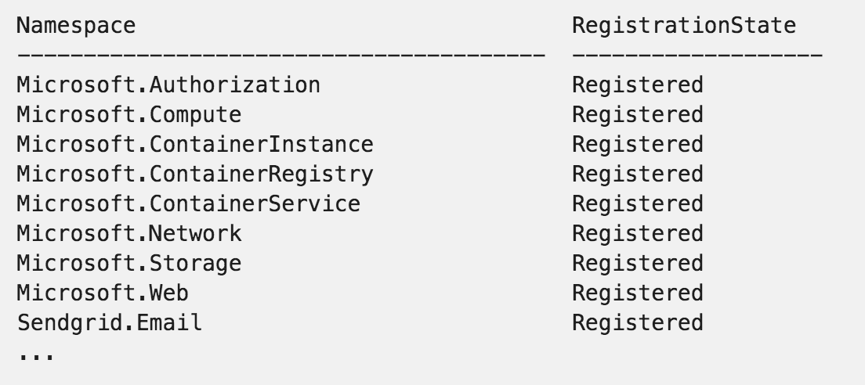
Azure Resource Manager
Resource Provider
A service that supplies the resources you can deploy and manage through Resource Manager.
Notes:
resource group
A container that holds related resources for an Azure solution. The resource group can include all the resources for the solution, or only those resources that you want to manage as a group.
You can deploy, update, or delete all the resources for your solution in a single, coordinated operation.
resource provider
A service that supplies the resources you can deploy and manage through Resource Manager.
Each resource provider offers operations for working with the resources that are deployed.
Some common resource providers are Microsoft.Compute, which supplies the virtual machine resource, Microsoft.Storage, which supplies the storage account resource, and Microsoft.Web, which supplies resources related to web apps. See Resource providers.

Slide 42
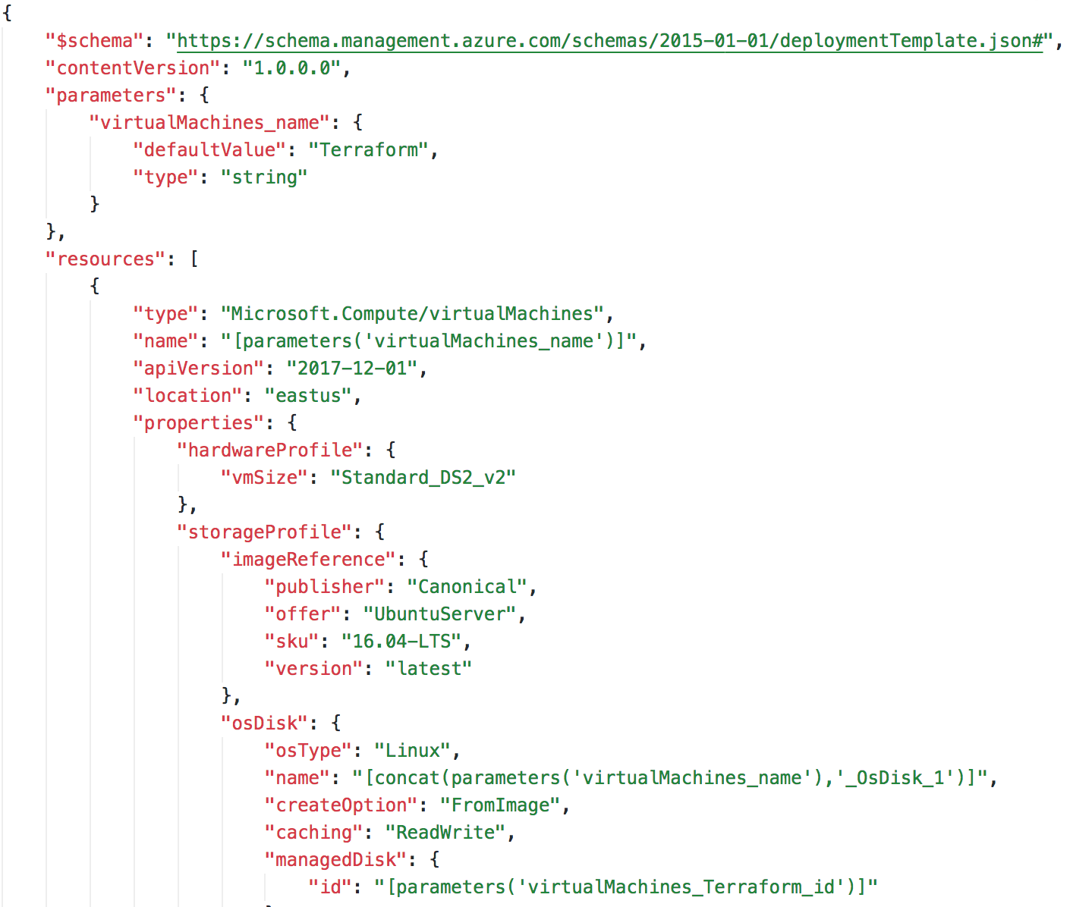
Azure Resource Manager Templates
ARM Templates
JSON file that defines one or
more resources to deploy to a
resource group.
Notes:
When you create anything in the Portal, it is creating an ARM Template and submitting that to a deployment.
Azure Deployment Model

Slide 43
ARM Templates Drawbacks
Cannot verify changes to an environment before executing
Failures can be difficult to trace
Deployments cannot cross resource groups (or subscriptions)
Custom tooling to create a full deployment
Linked templates require additional complexity
Notes:
There are other and overlapping tools out there.
Most tools combine plan and execution
One tool that can deploy to multiple platforms
Can represent infra and CDN or DNS services, etc…

Slide 44
Why Terraform?
Enables organizations to adopt an Infrastructure as Code
Import existing Infrastructure
Support for Linux and Windows Virtual Machines
Separate planning and execution phases
Represents entire infrastructure and supporting services with a common configuration language
Notes:
There are other and overlapping tools out there.
Most tools combine plan and execution
One tool that can deploy to multiple platforms
Can represent infra and CDN or DNS services, etc…
MICROSOFT!

Slide 45

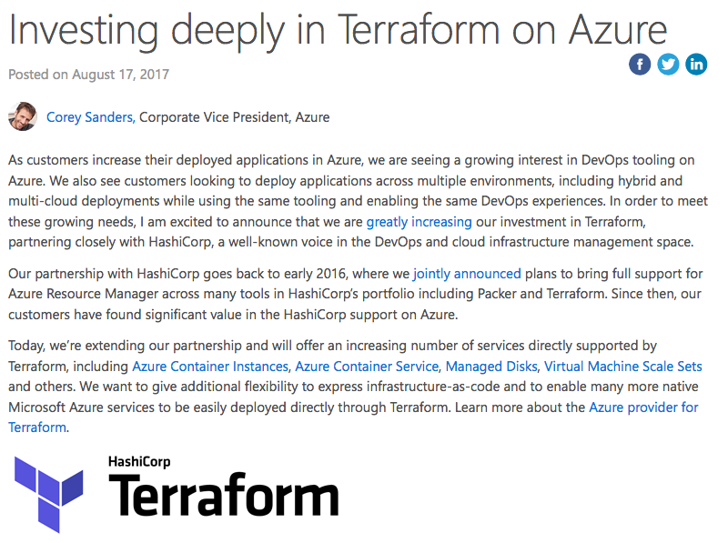
Microsoft Terraform
Microsoft Investing in Terraform
Azure Container Instance
Azure Kubernetes Service
https://aka.ms/terraform
https://aka.ms/terraformdocs
https://azure.microsoft.com/en-us/blog/investing-deeply-in-terraform-on-azure/
Notes:
2017, Hashicorp and Microsoft official partners.
Terraform is a first class citizen in Azure
Azurerm new resources quickly
ACI – GA
AKS – Day Zero Support
Event Grid - ~1 week

Slide 46
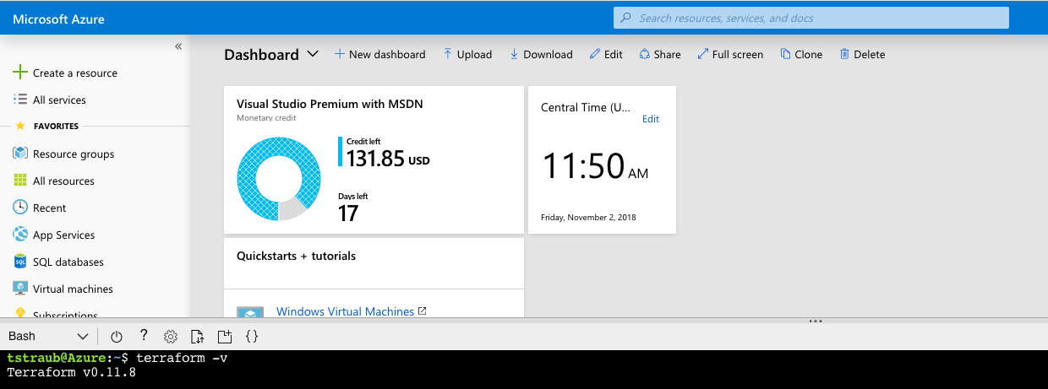
Microsoft Terraform
Azure Cloud Shell Integration
https://docs.microsoft.com/en-us/azure/terraform/terraform-cloud-shell
Notes:
Latest version of Terraform.
Can run Terraform from the Azure Cloud Shell – WILL DEMO THIS LATER

Slide 47
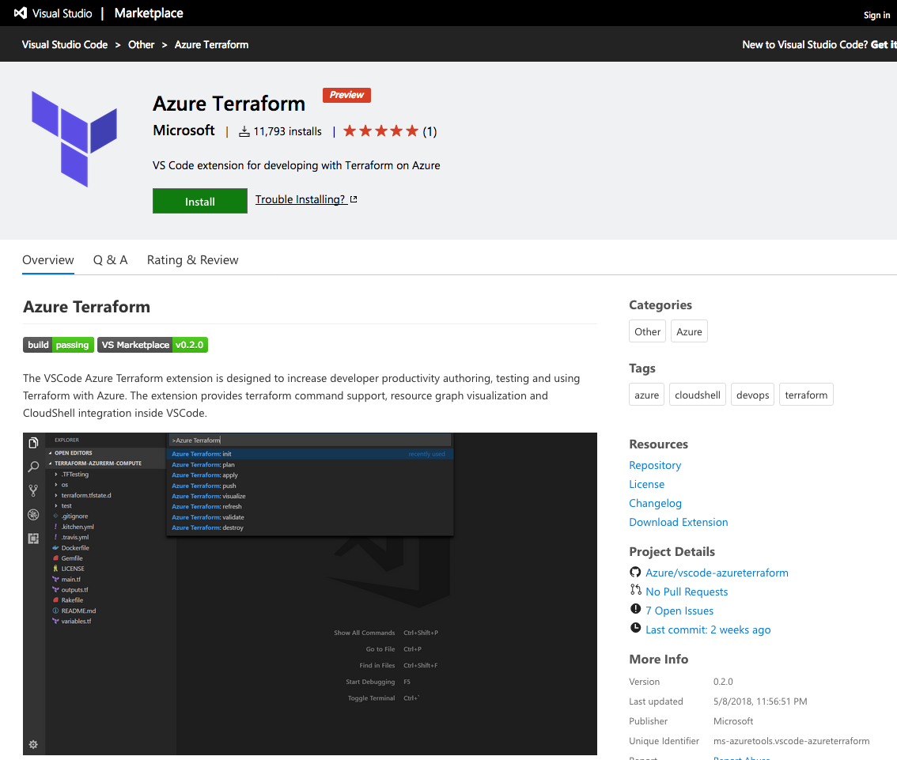
Microsoft Terraform
VS Code Extension
https://docs.microsoft.com/en-us/azure/terraform/terraform-cloud-shell
Notes:
Integrates with the Azure Cloud Shell
Allows pushing local code to the Cloud Shell
Preview

Slide 48
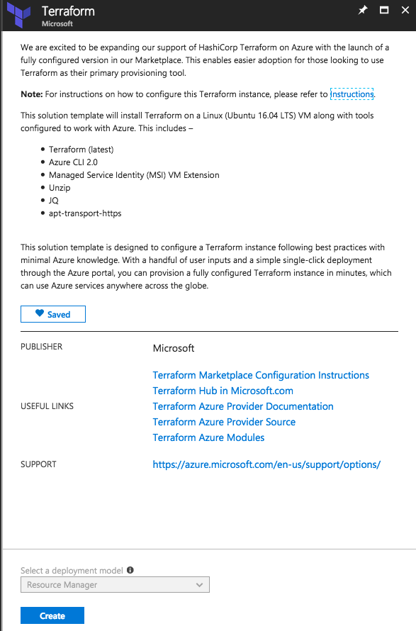
Microsoft Terraform
Terraform Marketplace Image
Creates a VM with system-assigned identity that's based on the Ubuntu 16.04 LTS image.
Installs the MSI extension on the VM to allow OAuth tokens to be issued for Azure resources.
Assigns RBAC permissions to the managed identity, granting owner rights for the resource group.
Creates a Terraform template folder (tfTemplate).
Pre-configures a Terraform remote state with the Azure back end.
https://aka.ms/aztfmkt
Notes:
Remote State Backend
Managed Service Identity – handles OATH

Slide 49
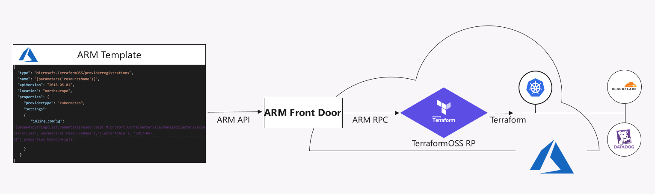
Microsoft Terraform
Terraform 3rd Party Azure Provider
https://azure.microsoft.com/en-us/blog/introducing-the-azure-terraform-resource-provider/
Notes:
Terraform built-in provider

Slide 50
Break
Notes:
[50m]

Slide 51
Terraform

Slide 52


Terraform
https://www.terraform.io/
Open Source Software
https://github.com/hashicorp/terraform
Written in GO
https://golang.org/
Notes:
OSS, hosted on Github
GoLang – single executable

Slide 53
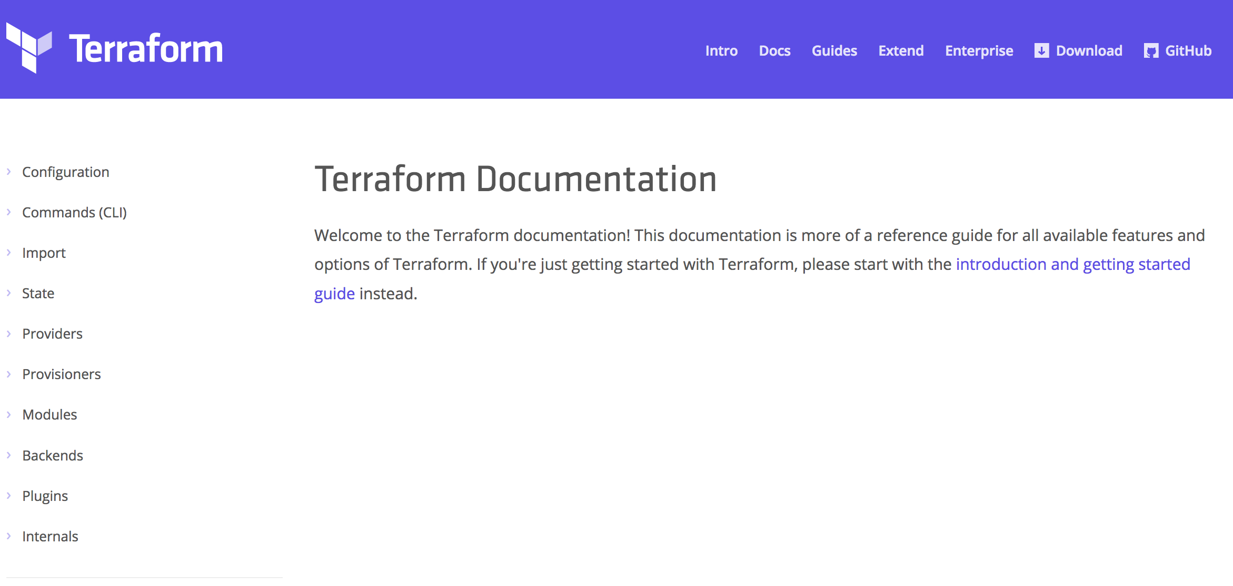
Terraform Documentation
https://www.terraform.io/docs
Notes:
Great documentation.
Constantly being updated.

Slide 54
Provision any infrastructure for any application
Core
Azure

Slide 55
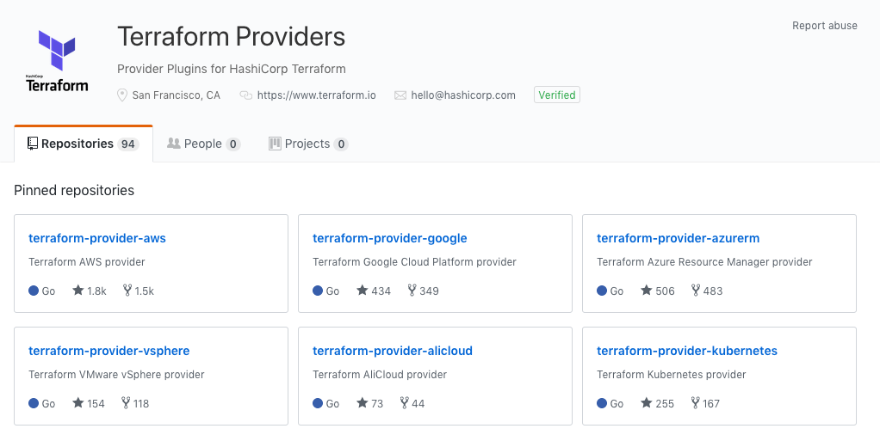
Terraform Providers
https://github.com/terraform-providers
Notes:
Terraform Providers are in their own Github Organization
Terraform only pulls in what is needed based on your configuration `terraform init`
Aka.ms/terraform

Slide 56
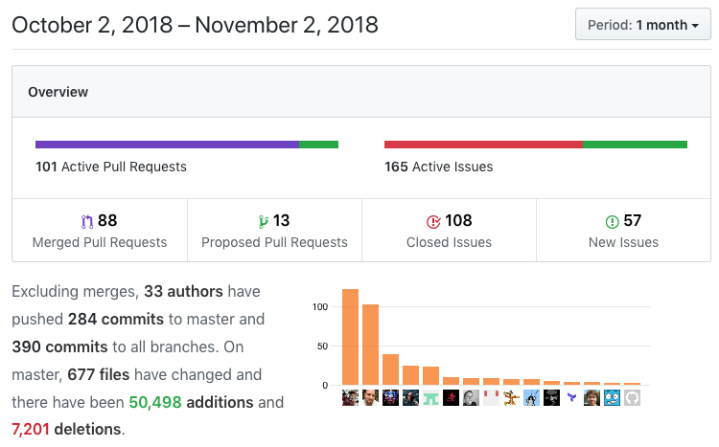
Azure Provider
150+ resources
Very active code base
Frequent releases
Jan 2018 -> v1.0.0
May 2018 -> v1.18.0
Great visibility into progress
https://github.com/terraform-providers/terraform-provider-azurerm
Notes:
150+ resources, more added every week.
Active code base – 88 Merged PR in 1 month
Frequent releases - 18 official releases in 10 months
Actively see what is being progress (Submit an Issue if you have a problem)

Slide 57
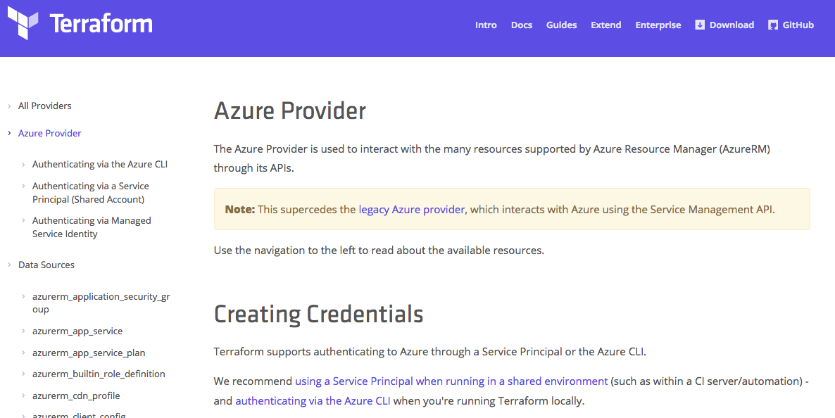
Azure Provider Documentation
https://www.terraform.io/docs/providers/azurerm

Slide 58
Hashicorp Configuration Language
Human-readable configuration (HCL) is designed for human consumption so users can quickly interpret and understand their infrastructure configuration.
HCL includes a full JSON parser for machine-generated configurations.
https://github.com/hashicorp/hcl

Slide 59
main.tf
resource "azurerm_resource_group" "myfirstrg" {
name = "myfirstresourcegroup"
location = ”eastus"
}
Notes:
‘resource’ is a TF Core type
‘azurerm_resource_group’ is an AzureRM provider resource.
‘myfirstrg’ is a scoping name to the resource (for planning, etc…)
‘name’ and ‘location’ are parameters set for a resource.
https://www.terraform.io/docs/configuration/syntax.html

Slide 60
Terraform in Action

Slide 61
Terraform Workflow
Init
Plan
Core
Provider
Apply
Notes:
Walk through the workflow
Only *.tf files that are in the current directory (nothing nested).
Init – happens once, pull dependencies
Plan

Slide 62
DEMO
Notes:
DEMO the basic init/plan/apply from the Azure Cloud Shell
Next few slides are back up/reference.

Slide 63
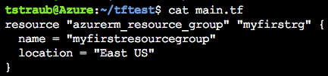
Notes:
Consider a simple resource group

Slide 64
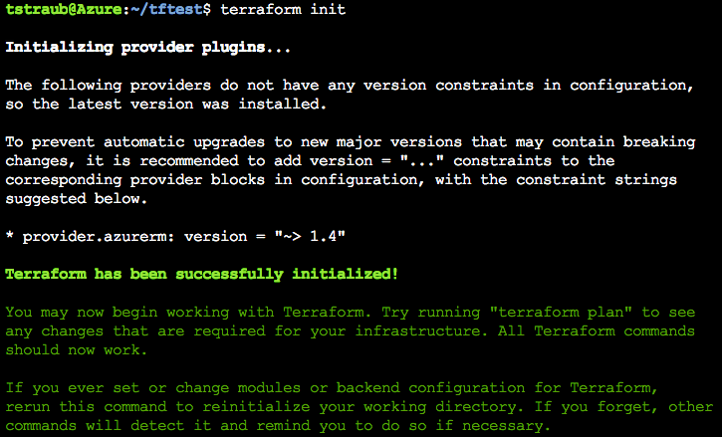
Notes:
Init
Reads configuration
initialize providers
Loads state file

Slide 65
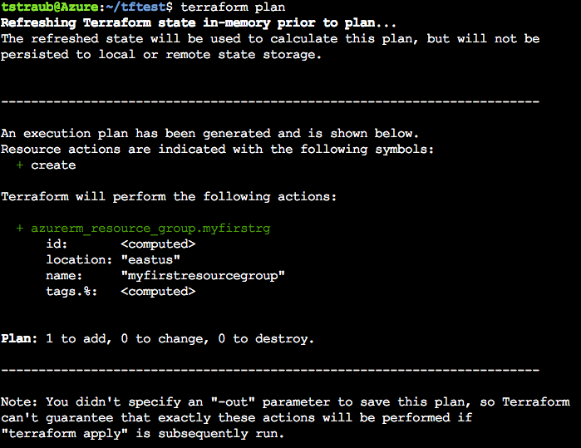
Notes:
Plan
Determines what infrastructure is needed and displays it

Slide 66
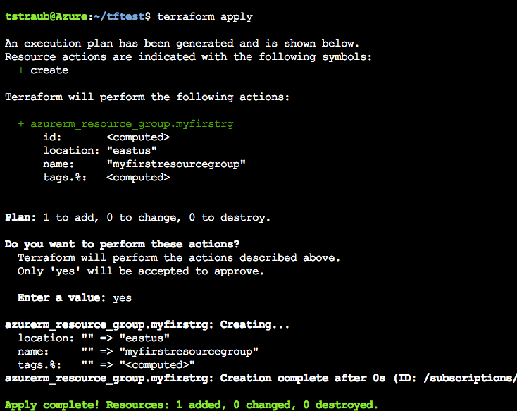
Notes:
Apply
Reruns a plan and prompts for confirmation before continuing
‘yes’ -> Applies the configuration

Slide 67
Terraform Configuration

Slide 68
Terraform
terraform {
required_version = "= 0.11.10"
}
= | Exact version equality | = 0.11.7
!= | Exclude version | != 0.11.6
> >= < <= | Version comparison | >= 0.11.4
~> | Pessimistic constraint | ~> 0.11.7
https://www.terraform.io/docs/configuration/terraform.html
Notes:
Not required.
Version pinning, good idea in production.
= is optional, defaults
Pessimistic will go up until the next major version

Slide 69
AzureRm Provider
provider "azurerm" {
version = ”= 1.18.0"
}
https://www.terraform.io/docs/providers/azurerm/index.html
Notes:
Specify the version
Same as terraform but for the provider.
Same compare rules.

Slide 70
Authentication to Azure
Azure CLI
az login
Uses your own credentials
Great for local development
Also how the Azure Cloud Shell works
Notes:
Great for testing
Can use this today, but since we will need the SP later, go ahead and create it

Slide 71
Authentication to Azure
Service Principal
Preferred for shared environments
Works well in automation
Also how Terraform Enterprise works
Notes:
You will generate these on your subscription in the challenges

Slide 72
Authentication to Azure
Service Principal
provider "azurerm" {
version = "1.10.0"
subscription_id = "SUBSCRIPTION-ID"
client_id = "CLIENT-ID"
client_secret = "CLIENT-SECRET"
tenant_id = "TENANT-ID"
}
Notes:
Can set them in the configuration

Slide 73
Authentication to Azure
Service Principal
export ARM_TENANT_ID=
export ARM_SUBSCRIPTION_ID=
export ARM_CLIENT_ID=
export ARM_CLIENT_SECRET=
Notes:
Preferred method
Easiest to blend into automation
How Terraform Enterprise will get these values.

Slide 74
Azure Location
resource "azurerm_resource_group" "main" {
location = "eastus"
}
resource "azurerm_resource_group" "main" {
location = “East US”
}
Notes:
Location equivalent
Pick either format, just be consistent
We use `eastus` in this workshop

Slide 75
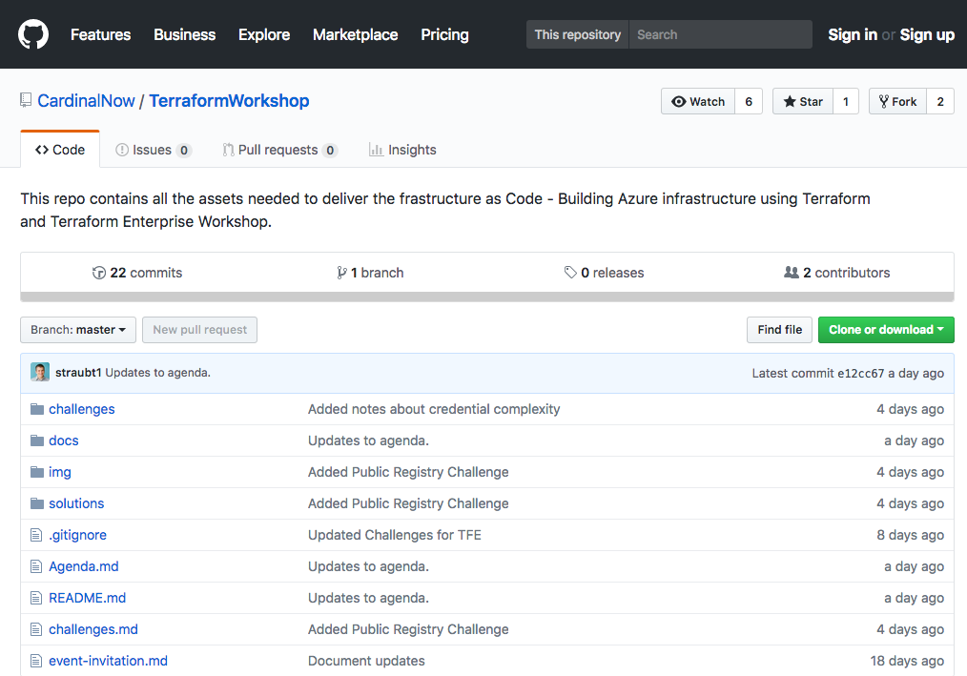
Workshop Repo
https://github.com/CardinalNow/TerraformWorkshop
Notes:
Walk through Repo

Slide 76
Challenge
00 - Getting Started
01 - Connecting to Azure
Notes:
30-45 mins Walk through the challenges
Setup Environment
Connect to the Azure CLI
Create a Resource Group
Goal: get setup/connected/building infrastructure
Combine this as a break

Slide 77
Challenge
00 - Getting Started
01 - Connecting to Azure
Notes:
How did it go?

Slide 78
Terraform State

Slide 79
Terraform State
File that stores state about your managed infrastructure
Keeps track of resource metadata
Used to map real world resources to your configuration.
Local terraform.tfstate file by default
https://www.terraform.io/docs/state

Slide 80
Terraform State
Config: Desired State
State: Current State
Diff: Delta of {Desired & Current}
Plan: Presents Diff
Apply: Resolves Diff
https://www.terraform.io/docs/state/remote.html

Slide 81
Terraform State
https://www.terraform.io/docs/state/remote.html
Notes:
Connecting these 3 points.

Slide 82

Terraform State
State file can contain sensitive data
https://www.terraform.io/docs/state/sensitive-data.html
Notes:
Do not store in source control
Such as usernames, passwords, keys…
Encrypted at rest in Azure storage accounts

Slide 83
Terraform State - Remote
Remote state
Backend
Local is default
Teams/collab
In memory state only
https://www.terraform.io/docs/state/remote.html

Slide 84
Terraform State – Operations
Configuration | State | Reality | Operation
azurerm_virtual_machine.app
https://www.terraform.io/docs/state/remote.html

Slide 85
Terraform State – Operations
Configuration | State | Reality | Operation
azurerm_virtual_machine.app |  |  | CREATE
https://www.terraform.io/docs/state/remote.html

Slide 86
Terraform State – Operations
Configuration | State | Reality | Operation
azurerm_virtual_machine.app |  |  | CREATE
azurerm_virtual_machine.app | azurerm_virtual_machine.app
https://www.terraform.io/docs/state/remote.html

Slide 87
Terraform State – Operations
Configuration | State | Reality | Operation
azurerm_virtual_machine.app |  |  | CREATE
azurerm_virtual_machine.app | azurerm_virtual_machine.app |  | CREATE
https://www.terraform.io/docs/state/remote.html

Slide 88
Terraform State – Operations
Configuration | State | Reality | Operation
azurerm_virtual_machine.app |  |  | CREATE
azurerm_virtual_machine.app | azurerm_virtual_machine.app |  | CREATE
azurerm_virtual_machine.app | azurerm_virtual_machine.app | azurerm_virtual_machine.app
https://www.terraform.io/docs/state/remote.html

Slide 89
Terraform State – Operations
Configuration | State | Reality | Operation
azurerm_virtual_machine.app |  |  | CREATE
azurerm_virtual_machine.app | azurerm_virtual_machine.app |  | CREATE
azurerm_virtual_machine.app | azurerm_virtual_machine.app | azurerm_virtual_machine.app | NOOP
https://www.terraform.io/docs/state/remote.html

Slide 90
Terraform State – Operations
Configuration | State | Reality | Operation
azurerm_virtual_machine.app |  |  | CREATE
azurerm_virtual_machine.app | azurerm_virtual_machine.app |  | CREATE
azurerm_virtual_machine.app | azurerm_virtual_machine.app | azurerm_virtual_machine.app | NOOP
 | azurerm_virtual_machine.app | azurerm_virtual_machine.app
https://www.terraform.io/docs/state/remote.html

Slide 91
Terraform State – Operations
Configuration | State | Reality | Operation
azurerm_virtual_machine.app |  |  | CREATE
azurerm_virtual_machine.app | azurerm_virtual_machine.app |  | CREATE
azurerm_virtual_machine.app | azurerm_virtual_machine.app | azurerm_virtual_machine.app | NOOP
 | azurerm_virtual_machine.app | azurerm_virtual_machine.app | DELETE
https://www.terraform.io/docs/state/remote.html

Slide 92
Terraform State – Operations
Configuration | State | Reality | Operation
azurerm_virtual_machine.app |  |  | CREATE
azurerm_virtual_machine.app | azurerm_virtual_machine.app |  | CREATE
azurerm_virtual_machine.app | azurerm_virtual_machine.app | azurerm_virtual_machine.app | NOOP
 | azurerm_virtual_machine.app | azurerm_virtual_machine.app | DELETE
 |  | azurerm_virtual_machine.app
https://www.terraform.io/docs/state/remote.html

Slide 93
Terraform State – Operations
Configuration | State | Reality | Operation
azurerm_virtual_machine.app |  |  | CREATE
azurerm_virtual_machine.app | azurerm_virtual_machine.app |  | CREATE
azurerm_virtual_machine.app | azurerm_virtual_machine.app | azurerm_virtual_machine.app | NOOP
 | azurerm_virtual_machine.app | azurerm_virtual_machine.app | DELETE
 |  | azurerm_virtual_machine.app | NOOP
https://www.terraform.io/docs/state/remote.html

Slide 94
Terraform State – Operations
Configuration | State | Reality | Operation
azurerm_virtual_machine.app |  |  | CREATE
azurerm_virtual_machine.app | azurerm_virtual_machine.app |  | CREATE
azurerm_virtual_machine.app | azurerm_virtual_machine.app | azurerm_virtual_machine.app | NOOP
 | azurerm_virtual_machine.app | azurerm_virtual_machine.app | DELETE
 |  | azurerm_virtual_machine.app | NOOP
azurerm_virtual_machine.app |  | azurerm_virtual_machine.app
https://www.terraform.io/docs/state/remote.html

Slide 95
Terraform State – Operations
Configuration | State | Reality | Operation
azurerm_virtual_machine.app |  |  | CREATE
azurerm_virtual_machine.app | azurerm_virtual_machine.app |  | CREATE
azurerm_virtual_machine.app | azurerm_virtual_machine.app | azurerm_virtual_machine.app | NOOP
 | azurerm_virtual_machine.app | azurerm_virtual_machine.app | DELETE
 |  | azurerm_virtual_machine.app | NOOP
azurerm_virtual_machine.app |  | azurerm_virtual_machine.app | RECREATE
https://www.terraform.io/docs/state/remote.html

Slide 96
Terraform State – Operations
Configuration | State | Reality | Operation
azurerm_virtual_machine.app |  |  | CREATE
azurerm_virtual_machine.app | azurerm_virtual_machine.app |  | CREATE
azurerm_virtual_machine.app | azurerm_virtual_machine.app | azurerm_virtual_machine.app | NOOP
 | azurerm_virtual_machine.app | azurerm_virtual_machine.app | DELETE
 |  | azurerm_virtual_machine.app | NOOP
azurerm_virtual_machine.app |  | azurerm_virtual_machine.app | RECREATE
 | azurerm_virtual_machine.app
https://www.terraform.io/docs/state/remote.html

Slide 97
Terraform State – Operations
Configuration | State | Reality | Operation
azurerm_virtual_machine.app |  |  | CREATE
azurerm_virtual_machine.app | azurerm_virtual_machine.app |  | CREATE
azurerm_virtual_machine.app | azurerm_virtual_machine.app | azurerm_virtual_machine.app | NOOP
 | azurerm_virtual_machine.app | azurerm_virtual_machine.app | DELETE
 |  | azurerm_virtual_machine.app | NOOP
azurerm_virtual_machine.app |  | azurerm_virtual_machine.app | RECREATE
 | azurerm_virtual_machine.app |  | REMOVE FROM STATE
https://www.terraform.io/docs/state/remote.html

Slide 98
Variables

Slide 99
Variables
variable "location" {
default = ”eastus"
description = ”Location to deploy Azure Infrastructure"
}
resource "azurerm_resource_group" "module" {
name = ”my-rg"
location = "${var.location}"
}
https://www.terraform.io/docs/configuration/variables.html
Notes:
Can be default or else required.
Default are literal and can not be interpolated.
Type is assumed.
Interpolation, more to come, VERY powerful
Description is purely for documentation (TF Registry)

Slide 100
Variables - Types
variable "key" {
type = "string"
default = "value"
}
https://www.terraform.io/docs/configuration/variables.html

Slide 101
Variables - Types
variable "images" {
type = "map"
default = {
"dev" = "image1"
"test" = "image2"
"prod" = "image3"
}
}
https://www.terraform.io/docs/configuration/variables.html
Notes:
Can be fragile

Slide 102
Variables - Types
variable "rules" {
type = "list"
default = ["rule1", "rule2"]
}
https://www.terraform.io/docs/configuration/variables.html

Slide 103
Variables - Types
variable "enabled" {
default = false
}
https://www.terraform.io/docs/configuration/variables.html

Slide 104
Variables - Scoping
Variables are valid within the current module level.
test
├── app1.tf
├── app2.tf
└── variables.tf
https://www.terraform.io/docs/configuration/variables.html
Notes:
All files can declare and use variables.
Share the same scope.
Can not duplicate.
Revisit when we reach modules.

Slide 105
Variables – How to Use
Defaults
https://www.terraform.io/docs/configuration/variables.html
Notes:
Already shown

Slide 106
Variables – How to Use
Variable Files
terraform.tfvars
*.auto.tfvars
terraform plan -var-file=vars.tfvars
foo = "bar"
valid = true
somelist = [
"one",
"two",
]
https://www.terraform.io/docs/configuration/variables.html

Slide 107
Variables – How to Use
Command Line Parameters
terraform plan –var ‘foo=bar’
terraform plan –var ‘foo=bar’ –var ‘bar=foo’
https://www.terraform.io/docs/configuration/variables.html
Notes:
Pass as many as you like
Duplicates will be overridden.

Slide 108
Variables – How to Use
Environment Variables (TF_VAR_*)
export TF_VAR_foo=bar
export TF_VAR_bar=foo
https://www.terraform.io/docs/configuration/variables.html
Notes:
Great for automation.

Slide 109
Outputs

Slide 110
Outputs
Outputs define useful values that will be highlighted to the user when Terraform applies:
IP addresses
Usernames
Computed Values
Easily extract and query information from all resources
https://www.terraform.io/docs/configuration/outputs.html
Notes:
Each resource has a lot of metadata, showing it all would be too difficult to sort through.
Computed Values (dynamic IPs)
Customized outputs

Slide 111
Outputs
output "vm_private_ips" {
value = "${azurerm_network_interface.app.private_ip_address}”
description = "Dynamic Private IP Addresses”
}
.
https://www.terraform.io/docs/configuration/outputs.html

Slide 112
Outputs
Outputs:
vm_private_ips = [
10.0.0.1,
10.0.0.2,
10.0.0.3
]
Notes:
Clean up this slde
`terraform refresh` when outputs change.
`terraform output` to view.

Slide 113
Challenge
02 - Provision Azure Container Instance
Notes:
Create an ACI

Slide 114
Interpolations

Slide 115
Interpolations
Embedded within strings in Terraform you can interpolate other values.
"${var.name}-rg"
The interpolation syntax is powerful and allows you to reference variables, attributes of resources, call functions, etc.
https://www.terraform.io/docs/configuration/interpolation.html

Slide 116
Interpolations – Count
variable "count" {
default = 2
}
resource "azurerm_network_interface" "web" {
name = "nic-${count.index}"
count = "${var.count}"
}
resource "azurerm_virtual_machine" "web" {
count = "${var.count}"
network_interface_ids = ["${element(azurerm_network_interface.web.*.id, count.index)}"]
}
Notes:
One of the most important!
count.index scoped to resource

Slide 117
Interpolations - Conditionals
resource "azurerm_virtual_machine" "web" {
subnet = "${var.size == "small" ? var.small_vm : var.large_vm}"
}
.
https://www.terraform.io/docs/configuration/interpolation.html

Slide 118
Interpolations – Built-In Functions
concat(list1, list2, ...) - Combines two or more lists into a single list.
concat(var.base_tags, var.additional_tags)
element(list, index) - Returns a single element from a list at the given index.
element(azurerm_subnet.foo.*.id, count.index)
element(var.list_of_strings, 2)
https://www.terraform.io/docs/configuration/interpolation.html
Notes:
Element() If the index is greater than the number of elements, this function will wrap using a standard mod algorithm.

Slide 119
Interpolations – Built-In Functions
format(format, args, ...) - Formats a string according to the given format. The syntax for the format is standard sprintf syntax.
Example to zero-prefix a count, used commonly for naming servers
format("web-%03d", 2).
https://www.terraform.io/docs/configuration/interpolation.html
Notes:
Format, for index =2 -> “web-002”

Slide 120
Interpolations – Math
resource "azurerm_virtual_machine" "module" {
name = "myvm-${count.index + 1}"
}
resource "azurerm_virtual_machine" "module" {
name = "${format("myvm-%03d", count.index + 1)}"
}
https://www.terraform.io/docs/configuration/interpolation.html

Slide 121
Interpolations – locals
variable "name" {
default = "dev"
}
locals {
module_name = "${var.name}-sql"
}
https://www.terraform.io/docs/configuration/locals.html
Notes:
Private variable

Slide 122
Modules

Slide 123
Modules
Root module:
The current working directory when you run terraform init/plan/apply, holding the Terraform configuration files.
It is itself a valid module.
Variable scoping:
Variables are scoped only to the module in which they are declared. There is no inheritance!
Notes:
You have been using modules all along.
Variable scoping.

Slide 124
Modules
Notes:
Detail the variable scoping
Too detailed, ignoring this diagram.

Slide 125
Module Usage
module ”mymodule" {
source = ”path/to/module"
name = "mysuperapp"
...
}
https://www.terraform.io/docs/modules

Slide 126
Module Sources
Local
Github
Generic git repo
Bitbucket
HTTP URLs
Registry (support versioning)
https://www.terraform.io/docs/modules/sources.html

Slide 127
Module Usage
module "windowsservers" {
source = "Azure/compute/azurerm"
version = "1.1.5"
location = ”eastus"
vm_hostname = "mywinvm"
vm_os_simple = "WindowsServer"
}
https://www.terraform.io/docs/modules

Slide 128
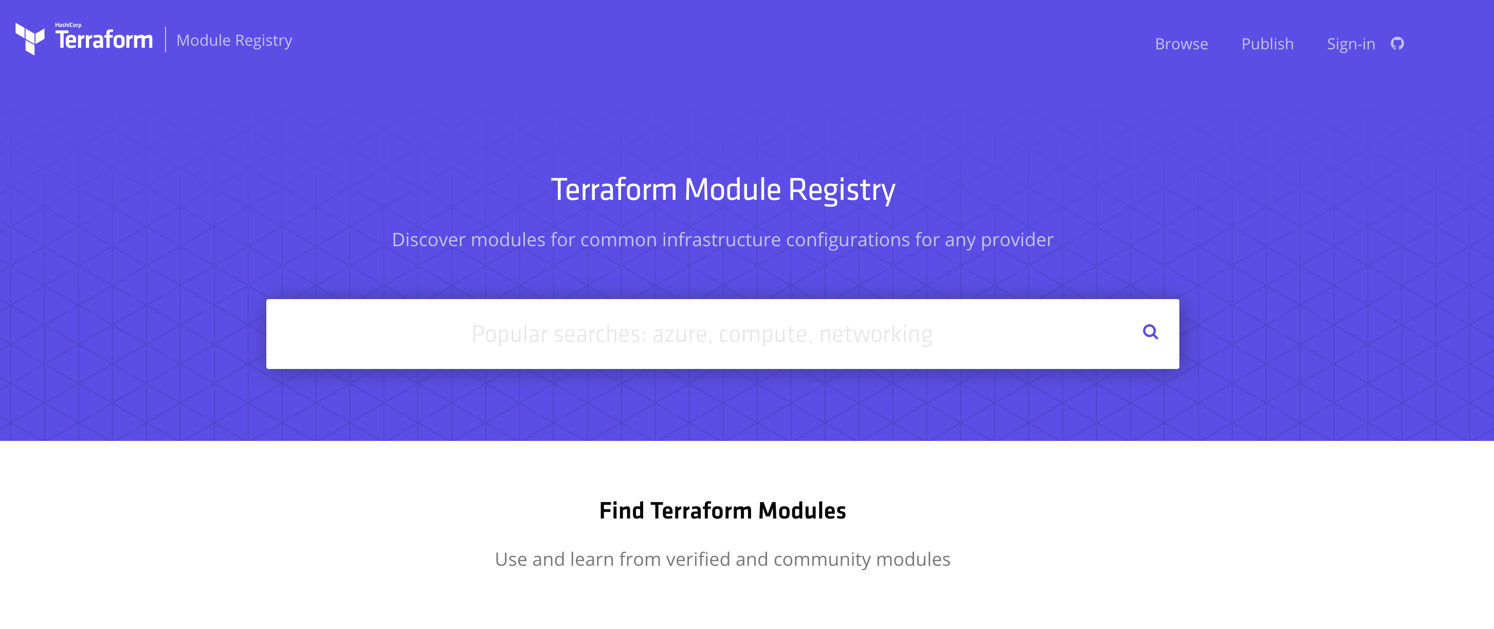
Public Module Registry
https://registry.terraform.io

Slide 129
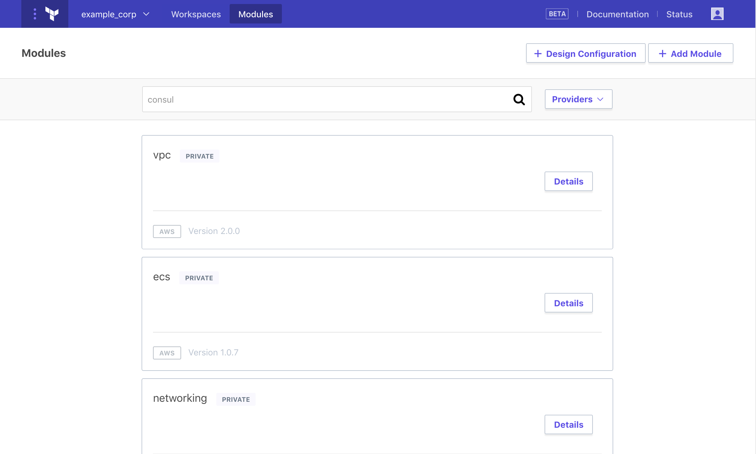
Private Module Registry
https://www.terraform.io/docs/enterprise/registry
Notes:
Terraform Enterprise

Slide 130
DEMO
Notes:
Public Module Registry
Search for compute

Slide 131
Challenge
03 - Provision Azure Virtual Machines
Notes:
Create a Virtual Machine step by step.
Scale the Virtual Machine.

Slide 132
Challenge
04 - Scaling Infrastructure with Count
Notes:
Create a Virtual Machine step by step.
Scale the Virtual Machine.

Slide 133
Solution Round Table
What are some of the pains you are having creating infrastructure in Azure?
What roadblocks do you see in adopting Terraform as your choice in IaC?
What concerns do you have with using Terraform?

Slide 134
Backend

Slide 135
Backend
Determines how state is loaded and how an operations are executed.
Enables non-local file state storage, remote execution, etc.
By default, Terraform uses the "local" backend.
https://www.terraform.io/docs/backends/types/index.html
Notes:
Use common state across others.

Slide 136
Backend- azurerm
terraform {
backend "azurerm" {
storage_account_name = "myorgeastus8x76ghf"
container_name = "terraformstate"
key = "dev.terraform.tfstate"
}
}
https://www.terraform.io/docs/backends/types/index.html

Slide 137
Backend
State Locking – Allows for teams to work together.
Backend Types:
azure SA
artifactory
Consul
Terraform Enterprise Manages this for you!!
https://www.terraform.io/docs/backends/types/index.html
Notes:
Independent of Terraform Provider
Consul
Consul value max = 512KB.

Slide 138
Terraform Internals

Slide 139
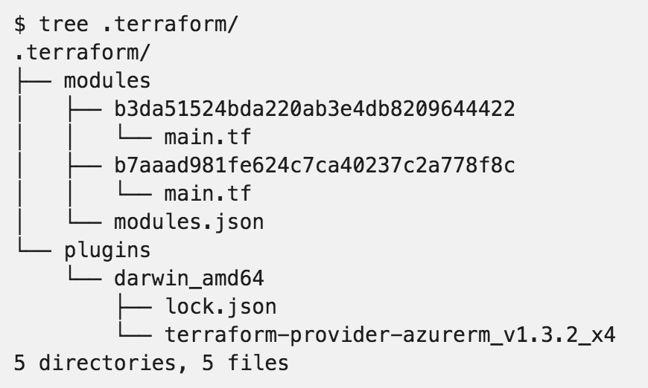
.terraform

Slide 140
Resource Addressing
Resource Address:
<MODULE PATH><RESOURCE SPEC>
azurerm_resource_group.module
module.A.azurerm_network_interface.web
https://www.terraform.io/docs/internals/resource-addressing.html

Slide 141
Resource Addressing
Module Path:
Addresses a module within a tree of modules.
module.A…
Can be multiple levels deep
module.A.module.B…
https://www.terraform.io/docs/internals/resource-addressing.html

Slide 142
Resource Addressing
Resource Spec:
resource_type.resource_name[N]
resource_type - Type of the resource being addressed.
resource_name - User-defined name of the resource.
[N] - where N is a 0-based index into a resource with multiple instances specified by the count meta-parameter.
https://www.terraform.io/docs/internals/resource-addressing.html

Slide 143
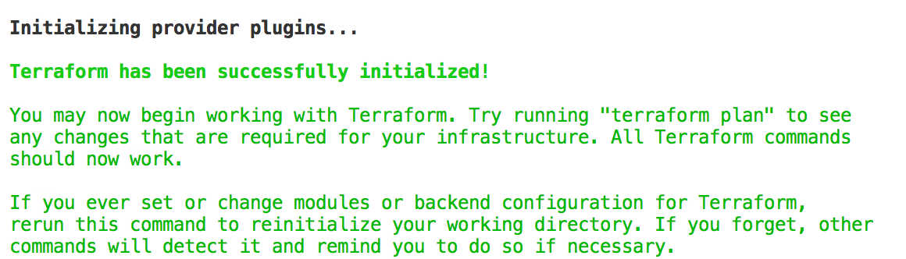
Commands - init
Usage: terraform init [options] [DIR]
https://www.terraform.io/docs/commands/init.html
Notes:
Can specify a DIR, but not recommended.

Slide 144
Commands - plan
Usage: terraform plan [options] [DIR-OR-PLAN]
Options:
-destroy If set, a plan will be generated to destroy all resources managed by the given configuration and state.
-parallelism=n Limit the number of concurrent operations. Defaults to 10.
-target=resource Resource to target.
https://www.terraform.io/docs/commands/plan.html

Slide 145
Commands - plan
Options:
-out=path Write a plan file to the given path.
-var 'foo=bar' Set a variable in the Terraform configuration. This flag can be set multiple times.
-var-file=foo Set variables in the Terraform configuration from a file.
https://www.terraform.io/docs/commands/plan.html

Slide 146
Commands - apply
Usage: terraform apply [options] [DIR-OR-PLAN]
https://www.terraform.io/docs/commands/apply.html

Slide 147
Commands - destroy
Usage: terraform destroy [options] [DIR]
https://www.terraform.io/docs/commands/destroy.html

Slide 148
Commands - fmt
Rewrites all Terraform configuration files in the current working directory.
Usage: terraform fmt [options] [DIR]
Options:
-check=false Check if the input is formatted. Exit status will be 0 if all input is properly formatted and non-zero otherwise.
https://www.terraform.io/docs/commands/fmt.html
Notes:
-check, great for CI server checks.

Slide 149
Commands - validate
Usage: terraform validate [options] [dir]
Validate the terraform files in a directory. Validation includes a basic check of syntax as well as checking that all variables declared in the configuration are specified.
https://www.terraform.io/docs/commands/validate.html

Slide 150
Commands - refresh
Usage: terraform refresh [options] [dir]
Update the state file of your infrastructure with metadata that matches the physical resources they are tracking.
This will not modify your infrastructure, but it can modify your state file to update metadata. This metadata might cause new changes to occur when you generate a plan or call apply next.
https://www.terraform.io/docs/commands/refresh.html

Slide 151
Commands - output
Usage: terraform output [options] [NAME]
Options:
-module=name If specified, returns the outputs for a specific module
-json If specified, machine readable output will be printed in JSON format
https://www.terraform.io/docs/commands/output.html

Slide 152
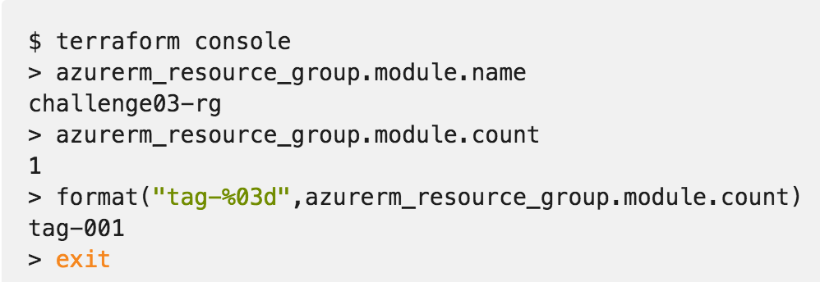
Commands - console
Creates an interactive console for interacting with Terraform.
Useful for experimenting with interpolations
and interacting with Terraform state.
https://www.terraform.io/docs/commands/console.html
Notes:
Doesn’t modify state
Can read remotes
Can work with out a state (just nothing to query)

Slide 153
Commands - graph
Usage: terraform graph [options] [DIR]
Outputs the visual execution graph of Terraform resources according to configuration files in DIR (or the current directory if omitted).
The graph is outputted in DOT format.
https://www.terraform.io/docs/commands/graph.html

Slide 154
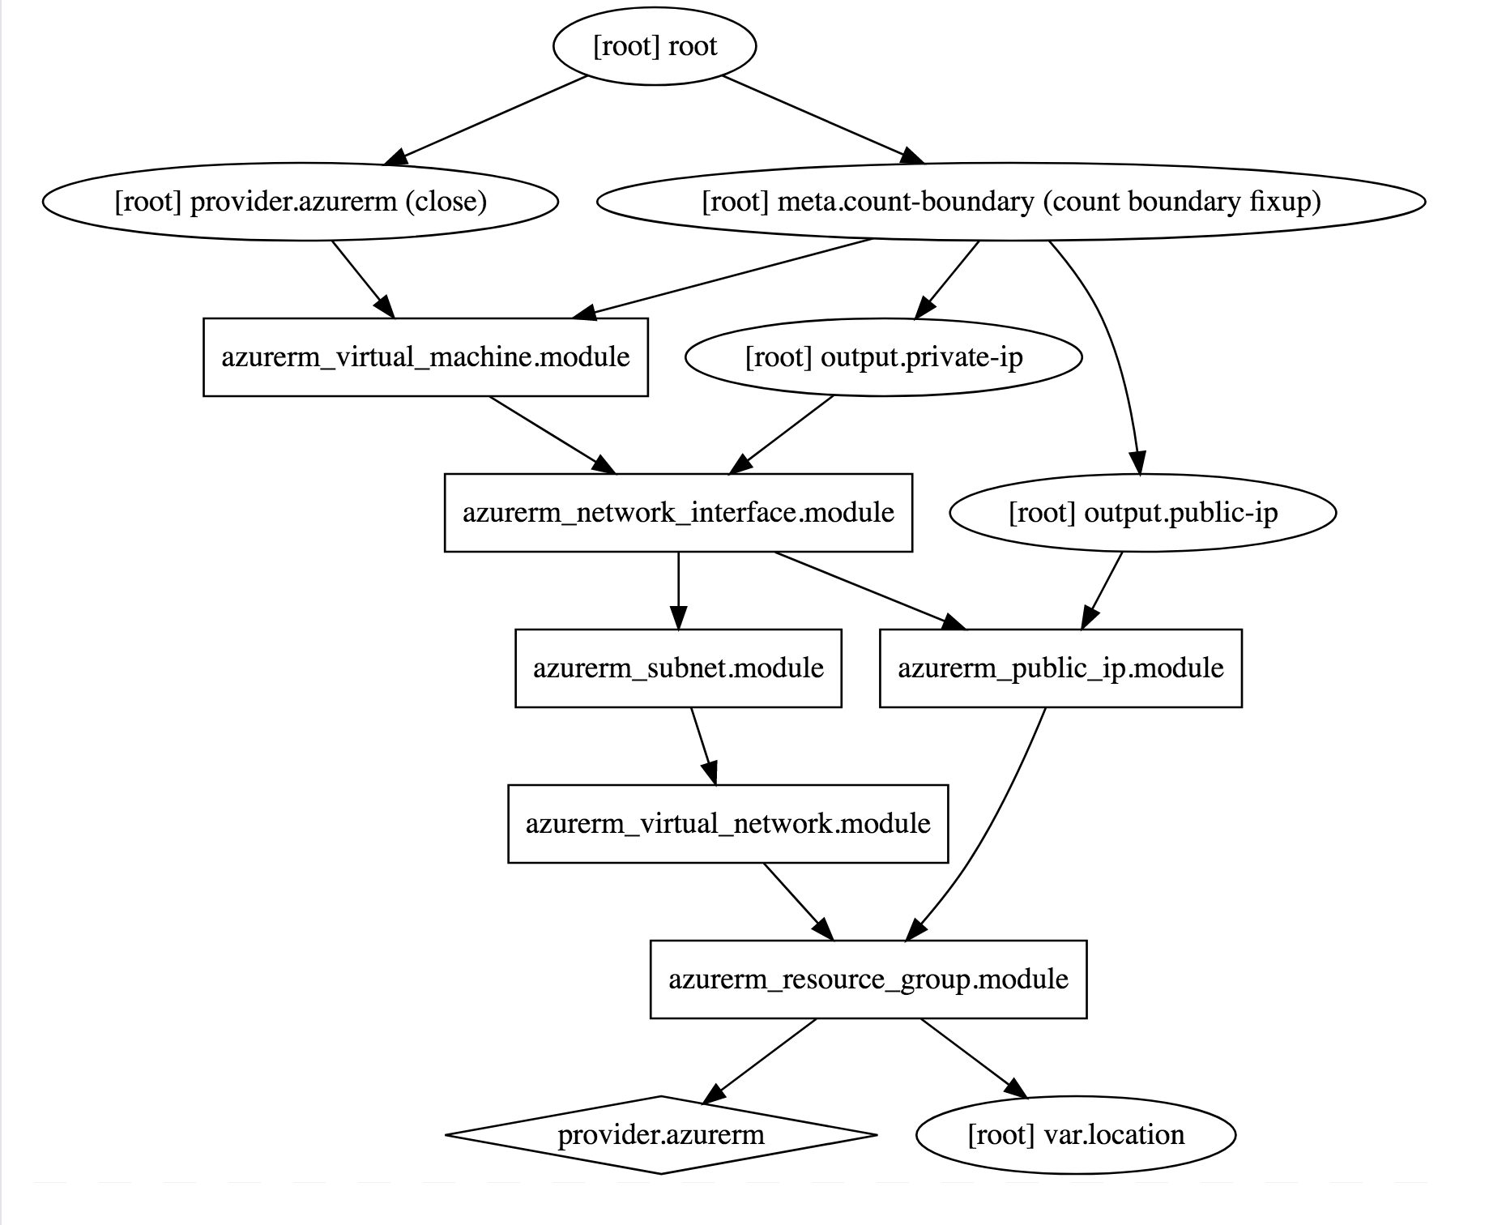
Commands - graph
terraform graph |
dot -Tsvg > graph.svg
https://www.terraform.io/docs/commands/graph.html

Slide 155
Advanced Commands
- state (list, mv, pull, push, rm, show)
- import
- taint/untaint

Slide 156
Challenge
06 – Public Module Registry
Notes:
Standup a Virtual Machine using the MS verified module.

Slide 157
Challenge
03 - Provision Azure Virtual Machines
04 - Scaling Infrastructure with Count
Notes:
Create a Virtual Machine step by step.
Scale the Virtual Machine.

Slide 158
Challenge
05 – Using Modules
06 – Public Module Registry
Notes:
Using modules

Slide 159
Terraform Enterprise

Slide 160
Terraform Open Source and Terraform Enterprise
OSS for technical complexity & Enterprise for organizational complexity
Governance
Organizational Complexity
Gold Support
Collaboration
Collaboration
Silver Support
Provisioning
Provisioning
Provisioning
Individuals use
OSS
Teams use
Pro
Organizations use
Premium
Notes:
Open Source:
IaC
Workflow (plan/apply)
Public Module Registry
Enterprise Pro:
Workspace Management GUI
VC Connections
Private Module Registry
SaaS
Enterprise Premium:
Private Install option
Policy as Code
Audit Logs

Slide 161
Terraform Open Source and Terraform Enterprise
OSS for technical complexity & Enterprise for organizational complexity
Governance
Organizational Complexity
Gold Support
Collaboration
Collaboration
Silver Support
Provisioning
Provisioning
Provisioning
Individuals use
OSS
Teams use
Pro
Organizations use
Premium
Notes:
The foundation of Terraform is the open source project and addresses the concern for individuals:
use infrastructure as code to create reusable configuration, enable automation, and manage infrastructure in cloud, at scale
use a consistent workflow for many different infrastructure providers to safely and consistently provision infrastructure and without having to learn other provision and management tools
As Terraform adoption grows beyond 1 or 2 users (which is how it generally begins) and as the organizational structure of infrastructure management grows there are a set of requirements around collaboration and governance that become helpful to using Terraform at scale for your organization.
Additionally to this, there is also the element of support for daily and long term success through enterprise levels of support. This includes both on-call support for daily issues but also long-terms architecture guidance and technical account management. This is what is offered as part of Terraform Enterprise. The focus of the Terraform Enterprise Pro is collaboration and the Terraform Enterprise Premium is governance.

Slide 162
Terraform OSS workflow for individuals
DEVELOPER
OPERATOR
VCS
Notes:
For collaboration, lets take a quick look back at the OSS workflow.
In this scenario there is 1 or 2 individuals using Terraform configurations to create and update the infrastructure.
And this is relatively simple to coordinate these changes.
However as more operators become proficient using Terraform and are brought on to help provision large scale infrastructures tis models expands.

Slide 163
How can teams safely collaborate on infrastructure
DEVELOPERS
OPERATORS
VCS
Notes:
Now there are multiple operators creating Terraform configurations, and in the case of more complex infrastructure one operator might be responsible for the networking infrastructure, and one operator responsible for the core infrastructure, and one operator responsible for web properties, etc.
Additionally, to this more operators are starting to consume the infrastructure provisioned by Terraform for their various different applications. The coordination of all of these runs is not trivial, each users is running their private installation of Terraform and updating the same infrastructure.

Slide 164
Workspaces

Slide 165
Workspace management and VCS connection
INFRASTRUCTURE AS CODE
DEVELOPERS
OPERATORS
Core
Provider
VCS
Notes:
To address this Terraform Enterprise provides Terraform Workspace management and UI with remote state storage, plans, and applies to remove the challenge of coordination.
Terraform Enterprise Workspaces has an API by design approach making it easy for you to integrate into your environment and existing tooling.
Workspaces are connected to Version control system repositories
Workspaces can be created in a granular way to align with how the infrastructure is organized. For example, workspaces can be organized by the stage of application delivery (development/test/production) and/or the type of infrastructure (networking/compute/monitoring/web).
Developer can use a private version of a module registry in the Terraform Enterprise UI to search for pre-defined modules to spin up infrastructure to run their applications.

Slide 166
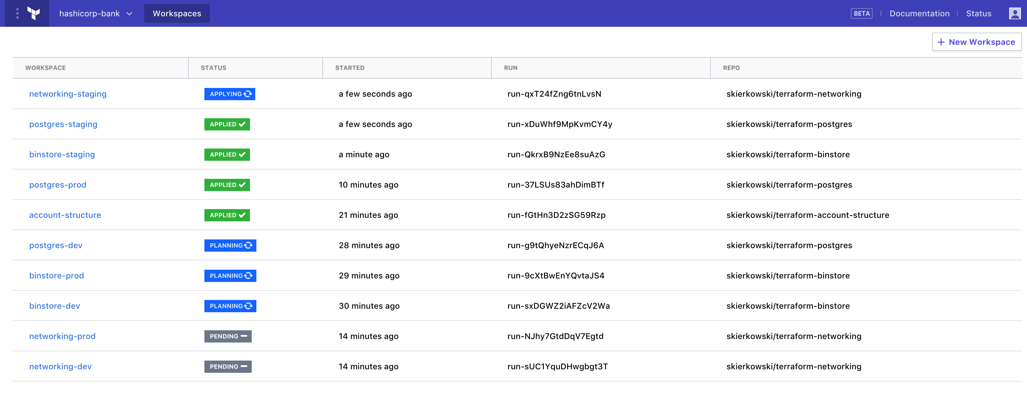
Workspace management and VCS connection
INFRASTRUCTURE AS CODE
TEAMS OF DEVELOPERS
TFE Workspace Management
TEAM OF OPERATORS
Core
Provider
VCS
Terraform Configuration
Notes:
Here is a view of Terraform Enterprise Workspace management with Workspace a the standard for how infrastructure is organized.
Run simil

Slide 167
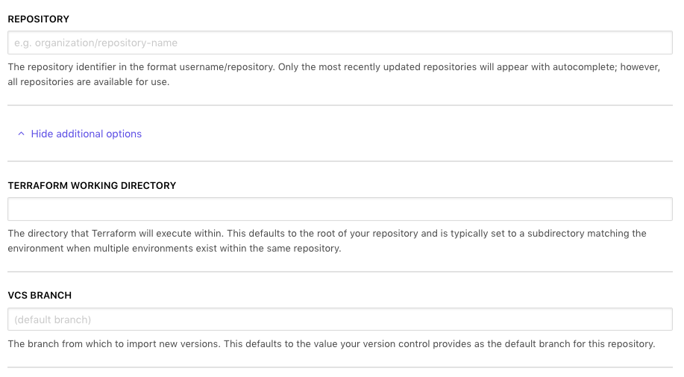
Workspace – VC Connection
https://www.terraform.io/docs/enterprise/vcs
Notes:
Version Control Connection – github, gitlab, bitbucket
Options:
- working directory
- branch

Slide 168
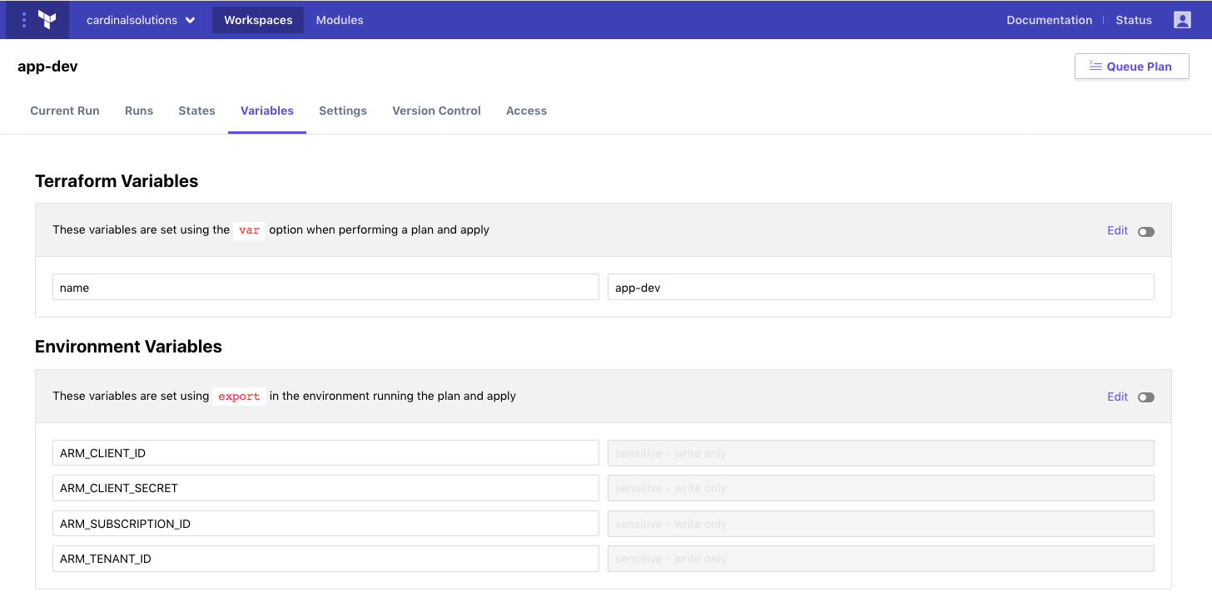
Workspace – Variables
https://www.terraform.io/docs/enterprise/workspaces/variables.html

Slide 169
Workspace – Variables
https://www.terraform.io/docs/enterprise/workspaces/variables.html
Notes:
HCL Type Variable
Sensitive
Nobody (including you) can view the value in TFE's UI or API. COULD BE IN LOGS
Nobody can edit the variable's name or value
Also works on ENV Vars

Slide 170
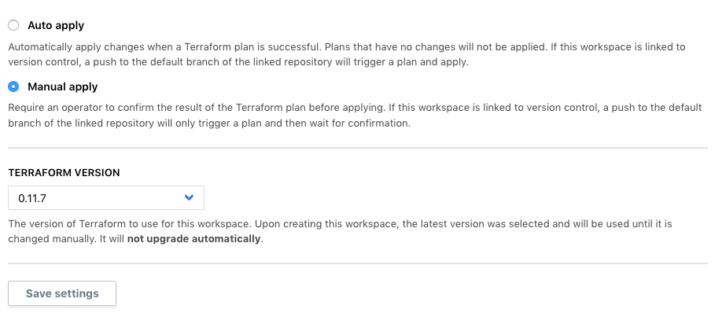
Workspace – Settings
https://www.terraform.io/docs/enterprise/workspaces/variables.html

Slide 171
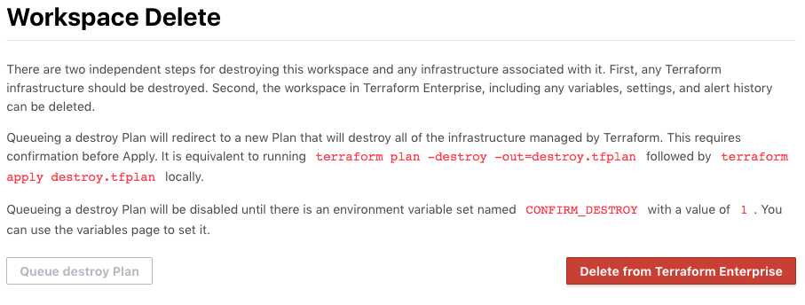
Workspace – Settings
https://www.terraform.io/docs/enterprise/workspaces/variables.html
Notes:
Deleting Works space infra
Update ENV Var
Click Destroy Plan

Slide 172
Remote State

Slide 173
Remote Terraform runs and state management
INFRASTRUCTURE AS CODE
PROVISIONING WORKFLOW
DEVELOPERS
Plan
OPERATORS
Core
Provider
Apply
Notes:
Terraform runs including the plan and apply can be done remotely.
Terraform Enterprise provides enhanced remote state storage
Runs triggered from the CLI also show up in the UI. Users can continue using the same OSS workflow (if that is what they are comfortable with) and it registers with TFE.

Slide 174
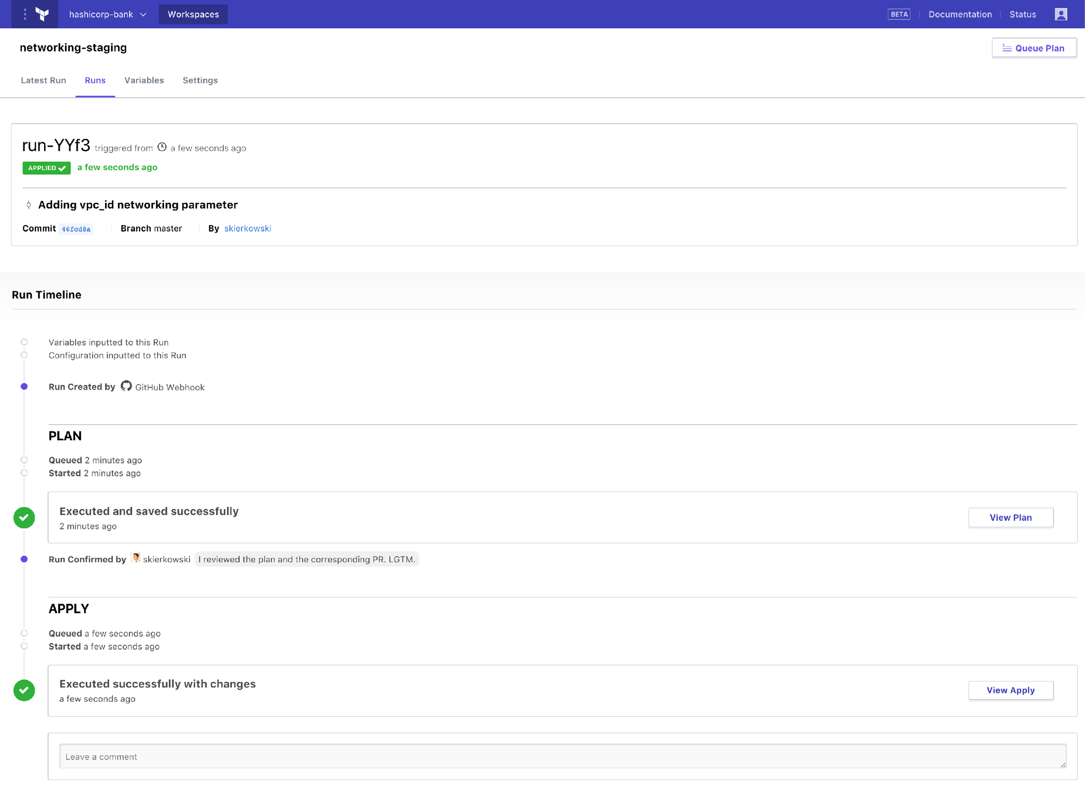
Remote state management and Terraform runs
INFRASTRUCTURE AS CODE
TEAMS OF DEVELOPERS
TFE Workspace Management
TEAM OF OPERATORS
Core
Provider
VCS
Terraform Configuration
Notes:
Here is a view of a Terraform run from Terraform Enterprise.
Terraform Infrastructure as code and Terraform Enterprise Workspace management and collaboration enables operators to automate provisioning at scale. However, this comes with risks, as every action can have larger effect.

Slide 175
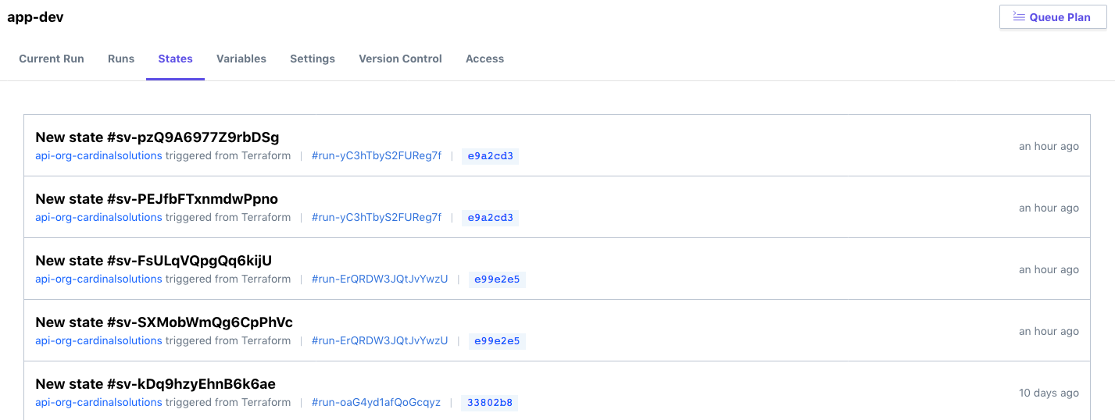
Workspace – State Management

Slide 176
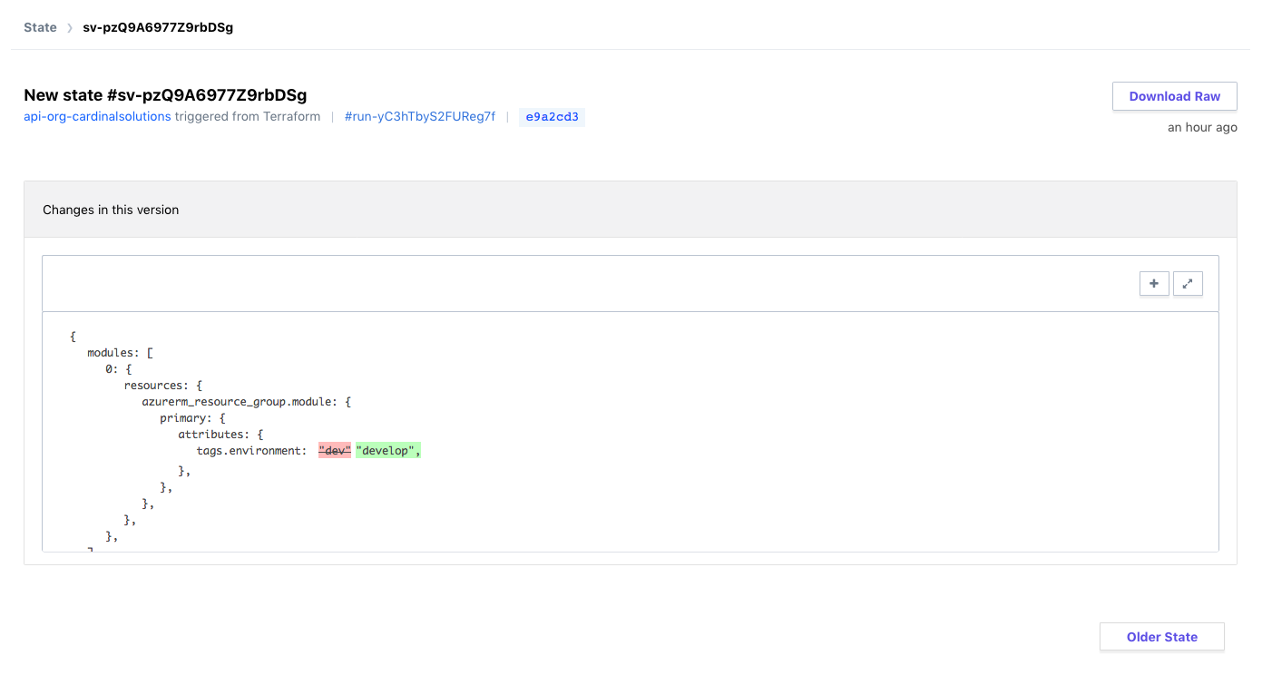
Workspace – State Management

Slide 177
Post-Session Survey
https://goo.gl/forms/kwuitMzjo9vJZKHz1
Notes:
Who here is in Azure now?
Using Terraform now?

Slide 178
Challenge
08 - Terraform Enterprise Setup

Slide 179
Demo

Slide 180
Collaboration

Slide 181
Collaboration
Role Based Access Controls
Permissions
Read
Write
Admin
Notes:
Devs can apply to dev environment, but not to Prod
Typical RBAC methodology

Slide 182
Collaboration
Role Based Access Controls
Organization
Teams
Users
Notes:
Devs can apply to dev environment, but not to Prod
Typical RBAC methodology

Slide 183
Service Accounts
API Tokens
User
Team
Organization
Notes:
Just as a user/team/org can be scoped, so can the API Tokens
Inherit the same permissions

Slide 184
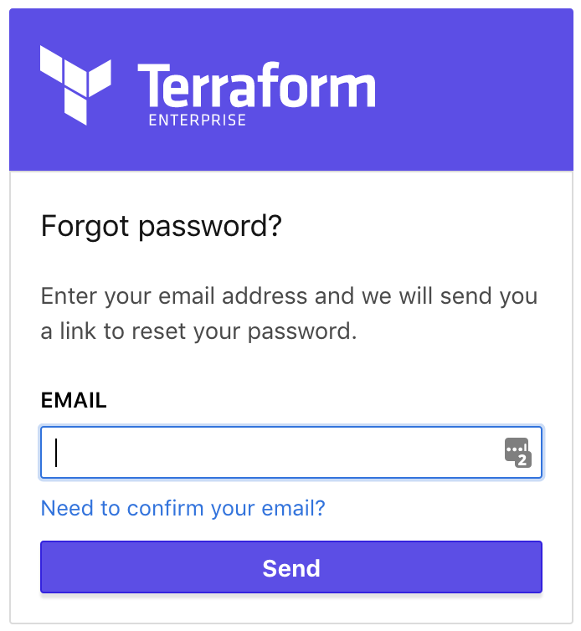
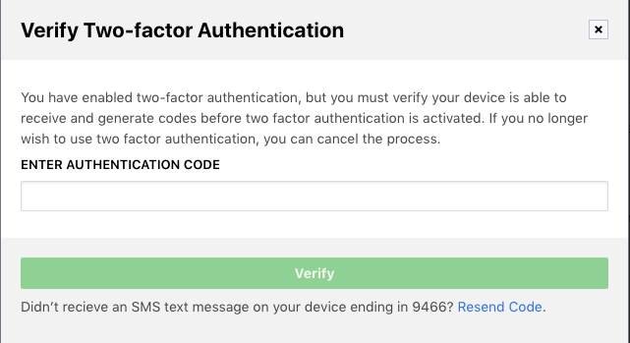
User Authentication
Notes:
Self Service Password Reset
2FA

Slide 185
Demo
Notes:
Create feature branch against workspace app-dev to update a tag.
Submit PR – see TFE running plans
These plans are temp and not linkable from TFE directly, use github.
Accept PR and see official plan.
Review and apply.

Slide 186
Private Module Registry

Slide 187
Private Module Registry
Modules for sharing across organization
Versioning
Self-Service Infrastructure
Documented, tested, and discoverable
Notes:
Used in the same way as the Public Module Registry.
Allows sharing/collaboration

Slide 188
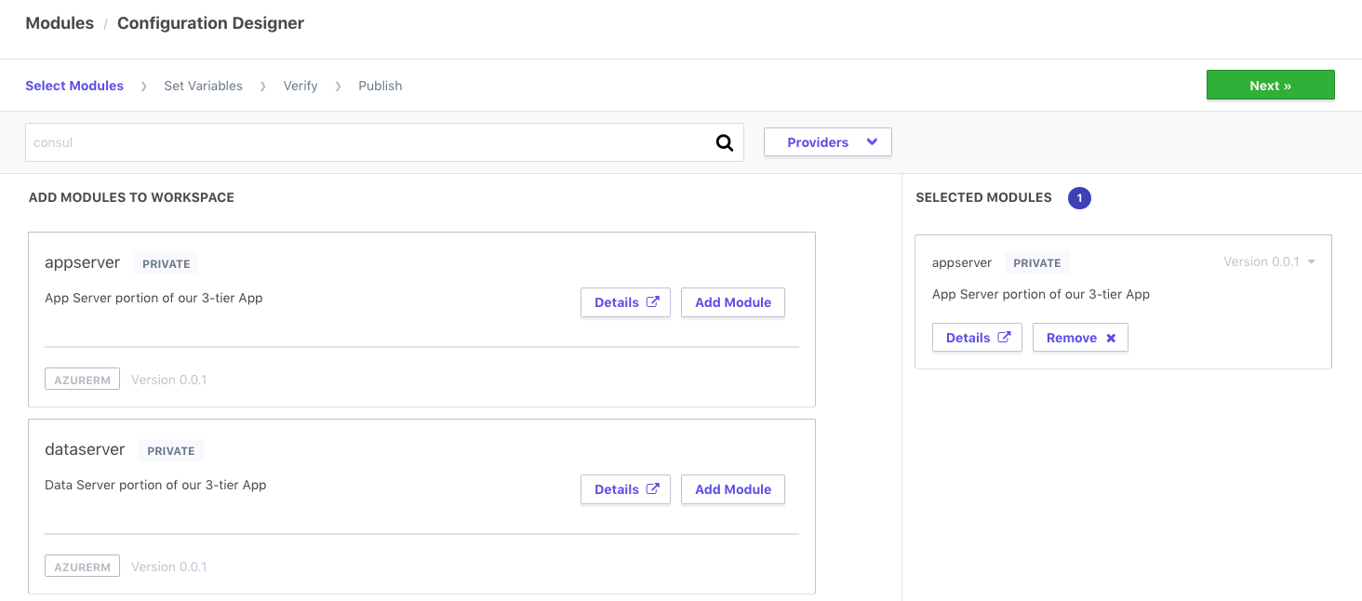
Design Configuration

Slide 189
Demo
Notes:
Create a new module design configuration.
Use an existing module and populate values.

Slide 190
Demo

Slide 191
Challenge
09 - Private Module Registry

Slide 192
Governance

Slide 193
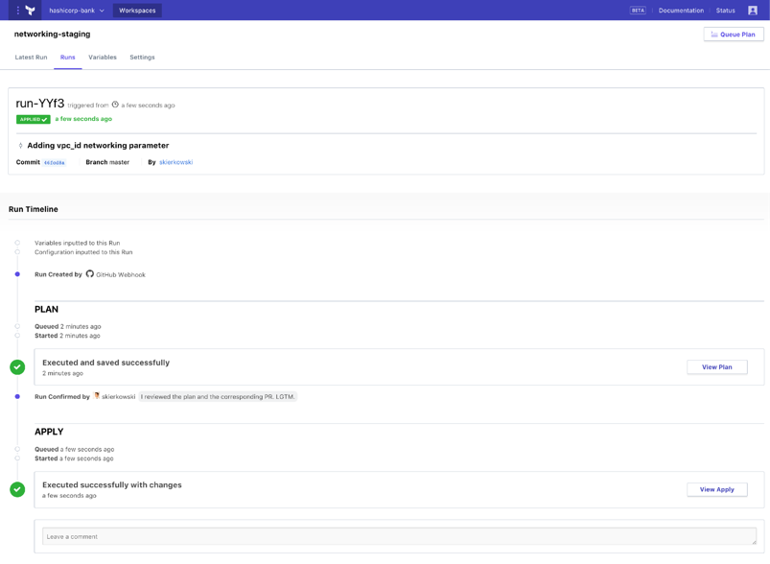
Enable Organization to have governance over infrastructure
Ensure provisioning policy is being maintained to minimize risk to the business
INFRASTRUCTURE AS CODE
PROVISIONING WORKFLOW
Extensible provider model
DEVELOPERS
Plan
GCP
√
OPERATORS
Core
Provider
√
AWS
√
Azure
√
Apply
Notes:
Then the execution phase happens and the resources are provisioned across the various providers detailed in the configuration file.
However, the as more resource are provisioned by more users the challenges is in making sure infrastructure changes are doing so within business and/or regulatory policy. Such policies might be:
Not allow resources to be provisioned without tags
Not allow “development” resources to be provisioned in “us-east-1”
Restrict AWS security group ingress and egress settings by CIDR block
Not allow resources to be provisioned outside of business hours
Manually trying to enforce these constraints will be difficult once usage scales beyond a few people provisioning infrastructure.
And to address this is policy as code to automate policy checks.

Slide 194
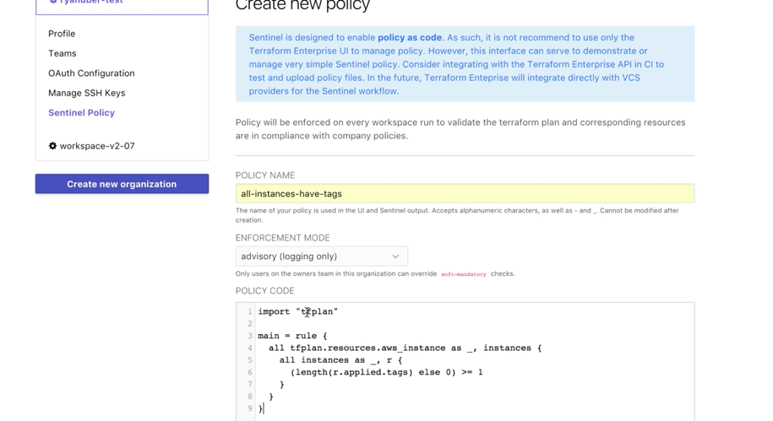
Enable Organization to have governance over infrastructure
Automate policy with Sentinel policy as code management
INFRASTRUCTURE AS CODE
DEVELOPERS
OPERATORS
Core
Provider
VCS
+ policy
Notes:
HashiCorp Sentinel is a policy as code framework and allows these types of constraints to be codified and automated with in Terraform Enterprise.
Sentinel policies are configured on an organization within Terraform Enterprise and are applied to all runs on all workspaces within that organization.
Policy code is entered into Terraform Enterprise using the API or the web UI, and full VCS integration for policy as code will be coming soon.

Slide 195

Enable Organization to have governance over infrastructure
Ensure provisioning policy is being maintained to minimize risk to the business
DEVELOPERS
Plan
OPERATORS
Core
Provider
Apply
Notes:
Example policy for infrastructure provisioning:
Do not allow resources to be provisioned without tags
Only allow staging resources in us-west-1 and production resources in us-east-1
Do not allow AWS security groups to have egress set to 0.0.0.0

Slide 196
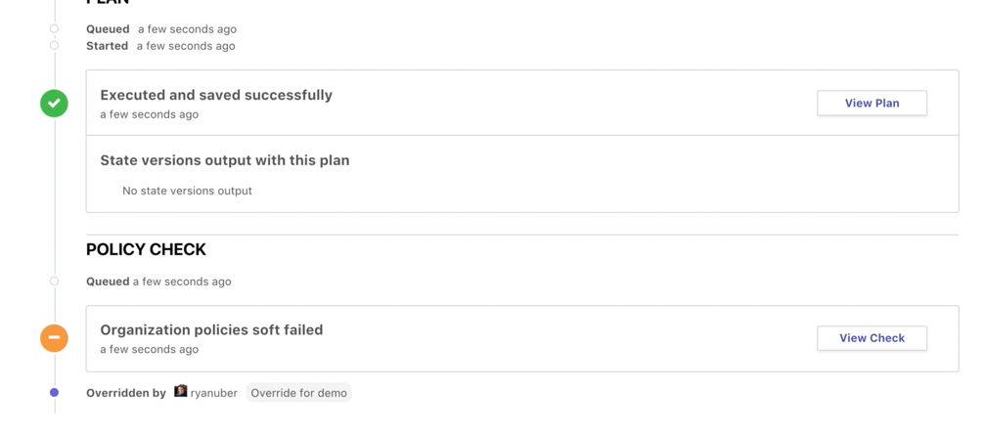
Enable Organization to have governance over infrastructure
Automate policy to be enforced on every Terraform run
INFRASTRUCTURE AS CODE
PROVISIONING WORKFLOW
DEVELOPERS
Plan
OPERATORS
Core
Provider
√
Apply
Notes:
The policy check is built into the Terraform workflow after the Terraform plan.
The “tfplan” plugin is imported, and then used to access the set of Terraform resources we are interested in, for the policy to actually be checking.
Sentinel policies in Terraform Enterprise are enforced immediately after a plan completes. This is reflected on the Runs view page. The “Policy Check” section will appear when the plan completes
For policy checks, there are various enforcement levels to provide the appropriate level of constraint while still enabling productivity. There are 3 levels to choose from:
Advisory mode logs warnings, but does not prevent runs from being applied. This is useful for teaching users good habits without preventing actions.
Soft mandatory mode requires an operator with appropriate permissions to override any policy failures prior to an apply. This is useful for policies like "Users cannot provision outside of business hours", which require a failsafe.
Hard mandatory mode does not allow any override, and policies must pass prior to an apply. This is useful for policies that enforce regulatory requirements like "All database volumes must be encrypted."
The workspace owner is able to confirm and apply a run that passes policy checks freely.

Slide 197

Enable Organization to have governance over infrastructure
Ensure provisioning policy is being maintained to minimize risk to the business
DEVELOPERS
Plan
OPERATORS
Core
Provider
Apply
Notes:
Here is a view of a Terraform run from Terraform Enterprise with the policy check applied after the Terraform plan.
This particular run had a soft fail that was able to be overridden by a user with the appropriate permission.

Slide 198
Enable Organization to have governance over infrastructure
Automate policy to be enforced on every Terraform run
INFRASTRUCTURE AS CODE
PROVISIONING WORKFLOW
Extensible provider model
DEVELOPERS
Plan
GCP
√
OPERATORS
Core
Provider
√
√
AWS
Azure
√
Apply
Notes:
With Sentinel policy as code the appropriate guardrails are automatically in-place to protect users from creating infrastructure changes that fall outside of business and/or regulatory policies.

Slide 199
Terraform Enterprise Provider

Slide 200

TFE Provider

Slide 201
TFE Provider
Configure your Enterprise instance with Terraform.
Useful for Workspaces, RBAC, and Sentinel Policies.

Slide 202
Challenge
10 - Sentinel Policy

Slide 203
Demo

Slide 204
Questions?

Slide 205
1 Week PoC
C
Pre-Requisites
- An available Azure subscription with sufficient funding
- Desired set of infrastructure to deploy to Azure
- Availability of required SMEs (application architects,
cloud architects, DevOps manager, etc.)
What You Will Get
- Purpose built infrastructure configuration based on your organizations needs/goals utilizing the best practices established performing large scale deployments
- Terraform configuration representing a one or more application environments including necessary networking (Vnets/Subnets/Peerings)
- Remote state configuration allowing for multiple team collaboration
- Terraform Enterprise integration and design considerations
- Presentation and documentation to prepare your teams to develop, maintain, and deploy your Terraform

